Slide 1
UNIT 5 RAILS & AJAX
by
Ranjani.B,
AP/CSE, EGSPEC

Slide 2
CONTENTS
RAILS - Overview of Rails- Document Requests- Processing Forms- Rails Application with Databases – Layouts
AJAX - Ajax Overview of Ajax – Basics of Ajax – Rails with Ajax.

Slide 3
Rails - Overview
Rails is a web application development framework written in the Ruby programming language. It is designed to make programming web applications easier by making assumptions about what every developer needs to get started. It allows you to write less code while accomplishing more than many other languages and frameworks.
Rails combines the Ruby programming language with HTML, CSS, and JavaScript to create a web application that runs on a web server. Because it runs on a web server, Rails is considered a server-side, or “back end,” web application development platform (the web browser is the “front end”).
The Rails philosophy includes two major guiding principles:
Don't Repeat Yourself: DRY is a principle of software development which states that "Every piece of knowledge must have a single, unambiguous, authoritative representation within a system". By not writing the same information over and over again, our code is more maintainable, more extensible and less buggy.
Convention Over Configuration: Rails has opinions about the best way to do many things in a web application, and defaults to this set of conventions, rather than require that you specify minutiae through endless configuration files.

Slide 4
What is Rails?
an application framework
› full stack: web server, actions, database
a programming environment
› eg, rake (like make), unit testing
an open-source community
› many plugins
History of Rails
genesis in Basecamp
› project management tool by 37signals
release
› open source in 2004
› shipped with OS X 10.5 in 2007
› Rails 3.1 in 2011, merging with Merb
Ruby on Rails creation
Ruby on Rails was created by David Heinemeier Hansson (DHH). He was working at 37signals (now Basecamp) company to create a project management application in Ruby. To help speed along the process, he created a custom web framework Ruby on Rails. It is also called Rails.

Slide 5
Ruby on Rails Features
Rails 5 was launched on 18th September 2015 by David Heinemeier Hansson in Atlanta. Some new features were implemented in Rails 5 version.
Some features are listed below:
Symbol garbage collector
Module #prepend
Keyword arguments
Action Mailer
Action view
Turbolinks
Action cable
Actionpack Assertions
Rails API
Render from anywhere
Rake command
Customized library
AJAX library

Slide 6
Symbol Garbage Collector
Passing symbols opens the possibility of several attacks in your system. The symbol garbage collector collects the symbols which prevents your system from several attacks.
Module #prepend
It allows you to insert a module in front of the class it was prepended.
Keyword Arguments
It supports keyword arguments which helps to reduce memory consumption by Rails application.
Action Mailer
New methods deliver_now or deliver_later are used instead of #deliver and #deliver!.
Action View
Helper methods like content_tag_for and div_for were removed from the core and moved out to a separate gem.

Slide 7
Turbolinks
Sometimes web pages reloads very slow because it loads full page from the server. Turbolinks 3 reloads only the content of the body, it doesn't reloads the whole page.
Action Cable
It is a framework which is used to extend Rails via Websockets to add some functionality. It very smoothly integrates Websockets with the rest of the Rails application. It allows you to easily add some real time features to your app.
ActionPack Assertions
The assertions assert_template and assigns() are deprecated and moved into its own gem.
Rails API
It allows you to generate API and cleans all the middleware which is not necessary for an application.

Slide 8
Render From Anywhere
Earlier we used gem render_anywhere to render views outside controller. In Rails 5, you can render your views from anywhere.
Rake Command
Rails 5 provides you a feature which allows you to restart all your apps with the rake restart command.
Customized URL
Search engine friendly URLs can be developed in Rails.
AJAX Library
Rails provide you an extensive library of AJAX functions. The associated java scripting required for AJAX gets generated automatically.

Slide 9
Rails Scripts
Rails provides us some excellent tools that are used to develop Rails application. These tools are packaged as scripts from command line.
Following are the most useful Rails scripts used in Rails application:
Rails Console
WEBrick Web Server
Generators
Migrations

Slide 10
Rails Console
The Rails console is as command line utility which runs Rails application from the command line. The Rails console is an extension of Ruby irb. It provides all the features of irb along with the ability to auto-load Rails application environment, including all its classes and components. It helps you to walk through your application step-by-step.
WEBrick Web server
Rails is configured to automatically use WEBrick server. This server is written in pure Ruby and supports almost all platforms like Windows, Mac or Unix. Alternatively, if you have Mongrel or light tpd server installed in your system, Rails uses either of those servers.
All the three Rails servers feature automatic reloading of code. It means, when you change your source code, you do not need to restart the server.

Slide 11
Generators
The Rails include code generation scripts, which are used to automatically generate model and controller classes for an application. Code generation increases your productivity when developing Web applications. By running generator command, skeleton files for all your model and controller classes will be generated. It also generates, database migration files for each model it generates.
Migrations
Migrations bring Rails DRY feature to life. It is a pure Ruby code that define the structure of a database. You don't have to use SQL to write your code while using migration.
The changes you make to your database schema is isolated in a separate migration file, which has a method to implement or reverse the change.

Slide 12
Ruby on Rails Directory Structure
On creating a Rails application, the entire Rails directory structure is created. We will explain Rails 5 directory structure here.
The jtp directory (shown below) has a number of auto-generated files and folders that comprises the structure of Rails application.

Slide 13
Ruby on Rails - Framework
A framework is a program, set of programs, and/or code library that writes most of your application for you. When you use a framework, your job is to write the parts of the application that make it do the specific things you want.
When you set out to write a Rails application, leaving aside the configuration and other housekeeping chores, you have to perform three primary tasks −
Describe and model your application's domain − The domain is the universe of your application. The domain may be a music store, a university, a dating service, an address book, or a hardware inventory. So here you have to figure out what's in it, what entities exist in this universe and how the items in it relate to each other. This is equivalent to modeling a database structure to keep the entities and their relationship.
Specify what can happen in this domain − The domain model is static; you have to make it dynamic. Addresses can be added to an address book. Musical scores can be purchased from music stores. Users can log in to a dating service. Students can register for classes at a university. You need to identify all the possible scenarios or actions that the elements of your domain can participate in.

Slide 14
Choose and design the publicly available views of the domain − At this point, you can start thinking in Web-browser terms. Once you've decided that your domain has students, and that they can register for classes, you can envision a welcome page, a registration page, and a confirmation page, etc. Each of these pages, or views, shows the user how things stand at a certain point.
Based on the above three tasks, Ruby on Rails deals with a Model/View/Controller (MVC) framework.
Ruby on Rails MVC Framework
The Model View Controller principle divides the work of an application into three separate but closely cooperative subsystems.
Model (ActiveRecord )
It maintains the relationship between the objects and the database and handles validation, association, transactions, and more.
This subsystem is implemented in Active Record library, which provides an interface and binding between the tables in a relational database and the Ruby program code that manipulates database records. Ruby method names are automatically generated from the field names of database tables.

Slide 15
View ( ActionView )
It is a presentation of data in a particular format, triggered by a controller's decision to present the data. They are script-based template systems like JSP, ASP, PHP, and very easy to integrate with AJAX technology.
This subsystem is implemented in Action View library, which is an Embedded Ruby (ERb) based system for defining presentation templates for data presentation. Every Web connection to a Rails application results in the displaying of a view.
Controller ( ActionController )
The facility within the application that directs traffic, on the one hand, querying the models for specific data, and on the other hand, organizing that data (searching, sorting, messaging it) into a form that fits the needs of a given view.
This subsystem is implemented in ActionController, which is a data broker sitting between ActiveRecord (the database interface) and ActionView (the presentation engine).

Slide 16
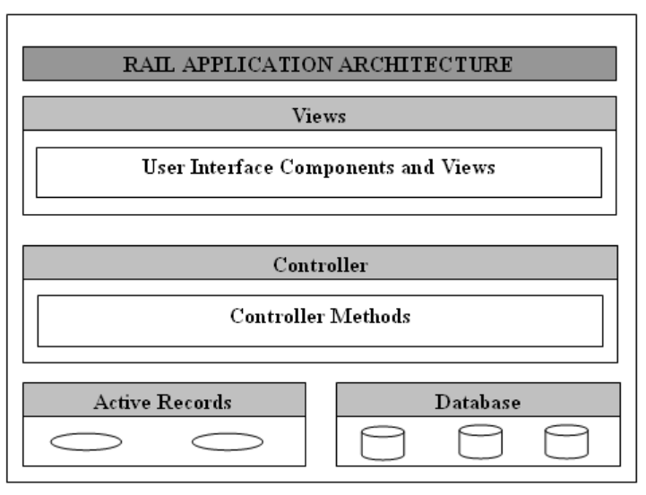
Pictorial Representation of MVC Framework

Slide 17
When you use the Rails helper script to create your application, it creates the entire directory structure for the application. Rails knows where to find things it needs within this structure, so you don't have to provide any input.
Here is a top-level view of a directory tree created by the helper script at the time of application creation. Except for minor changes between releases, every Rails project will have the same structure, with the same naming conventions. This consistency gives you a tremendous advantage; you can quickly move between Rails projects without relearning the project's organization.

Slide 18
Active Record
Data structures are represented by a hierarchy of classes. Data is mostly stored in relational database tables. There is an essential mismatch between your program's object view and database's relational data view. To remove this mismatch, many attempts have been tried. One way to resolve this mismatch was through the use of Object-relational-mapping (ORM) tools. ORM is the mapping of relational database tables to object-oriented classes.
A perfect ORM hides the details of a database's relational data behind the object hierarchy. In Rails, ORM is implemented by Active Record which is one of the most important components of the Rails library.

Slide 19
An ORM provides a mapping layer between how a database handles its data and how an object-oriented application handles its data. It maps database tables to classes, database table rows to objects, and database tables columns to object attributes. Active Record mainly carries out the mapping process for you. While using Active Record, you have to no longer deal with database constructs like tables, rows or columns. Your application only deals with classes, attributes and objects.

Slide 20
Active Record is based on a design pattern created by Martin Fowler. From this design pattern only, the Active Record got its name. Its code works very well even with less number of lines. It is quite easy to use. Active Record Rails application does not need any configuration at all, if proper naming schemes is followed in your database and classes.
There is one more feature of Active Record that makes your work easy, the implementation of a domain-specific-language (DSL). A DSL is a programming language intended to use in a specific problem domain. It allows you to use dynamically generated methods, like to retrieve a record, method find_by_first_name is used.

Slide 21
Active Record Basics
Some of the basics of Active Record are classes, objects and naming conventions.
Active Record Classes and Objects
Each table in a database is generally represented by a class that extends Active Record base class. By extending Active Record base classes, model objects inherit a lot of functionalities.
While using Active Records, you don't have to set up any database connections. It manages all the database connections for an appication. It adds attributes to your class for each of the columns in the database.
Active Record naming conventions
Active Record uses the CoC (convention over configuration) principle. On following naming convention, you can take advantage of many dynamic features of Active Record without any configuration.

Slide 22
Class and Database
Database table should be named in the plural form and in lowercase of your model classes. For example, if a model class name is Student, then corresponding table name will be students. With the help of this convention, Rails will automatically find the corresponding table to your model class without any configuration code. It even supports plural nouns such as 'people' as the plural of 'person'.
Rails provides a facility where you can add plurals for a model. To define your own pluralization, add code to the config/environment.rb using Inflector.
In some case, if you don't want to name your database in the plural form, Rails can be configured with singular-named database tables by adding following line to the config/environment.rb :
ActiveRecord::Base.pluralize_table_names = false

Slide 23
Ruby on Rails Migrations
Migrations are a way to alter database schema over time in a consistent and organized manner. They use a Ruby DSL through which there is no need to write SQL by hand.
SQL fragments can be edited by hand but then you have to tell other developers about the changes you made and then run them. You need to keep track of changes that need to be run against production machines next time you deploy.
Each migration is a new version of the database. Each migration modifies database by adding or removing tables, columnns or entries. Active record will update your db/schema.rb file to match up-to-date structure of your database.

Slide 24
Purpose of Migrations
It is important to know the purpose of migration before using it. Database is used in all web applications.
Generally, a SQL statement is used to run database queries to create, modify, read or delete columns of a database.
Migration file contains a specific set of instructions for how a database should be created. When this file is run, Rails will make changes in the database automatically. Gradually, the migration file will act as a versioned history of how database has changed. It implies that you will be able to recreate the database from the set of instructions file.

Slide 25
Creating Migration file
Syntax to create a migration file:
application_dir> rails generate migration table_name
This will create a file with the name db/migrate/001_table_name.rb. A migration file contains basic data structure of a database table.
It is advisable that before running the migration generator, clean the existing migrations generated by model generators.
Example:
Let us create a migration called java in the application tutorials.
rails generate migration java

Slide 26
Editing Code
Go to db/migrate directory in the tutorials application. Write the following code in the present file 001_java.rb,
class Java < ActiveRecord::Migration
def self.up
create_table :java do |t|
t.column :title, :string, :limit => 32, :null => false
t.column :fee, :float
t.column :duration, :integer
t.column :index, :string
t.column :created_at, :timestamp
end
end
def self.down
drop_table :java
end
end

Slide 27
The method self.up is used during migrating to a new version and self.down is used to roll back any changes if needed.
Run Migration
After creating all the required migration files you need to execute them. To execute migration file against database, run the following code:
rake db:migrate
It will create a "schema_info" table if doesn't exist. It tracks the current version of the database.
If new migration will be created then that will be a new version for the database.

Slide 28
Rails Layout
In Rails, layouts are pieces that fit together (for example header, footer, menus, etc) to make a complete view. An application may have as many layouts as you want. Rails use convention over configuration to automatically pair up layouts with respective controllers having same name.
Rails layouts basically work on Don't Repeat Yourself principle (DRY).
In Rails, layouts are enabled by default. Whenever you generate a new Rails application, a layout is automatically generated for you in app/views/layouts.
First we need to define a layout template and then define the path for controller to know that layout exists.

Slide 29
Creating Responses
There are three ways to create an HTTP response from the controller's point of view:
Call render to create a full response to send back to the browser
Call redirect_to to send an HTTP redirect status code to the browser
Call head to create a response to end back to the browser
Importance of yield statement
The yield statement in Rails decides where to render the content for the action in layout. If there is no yield statement in the layout, the layout file itself will be rendered but additional content into the action templates will not be correctly placed within the layout.
Hence, a yield statement is necessary to add in a layout file.
<%= yield %>

Slide 30
Relation between Rails Layouts and Templates
When a request is made in an application, following process occur:
First of all, Rails find a template for corresponding action to render method in your controllers action.
Then finds correct layout to use.
It uses action template to generate a content specific to the action.
Finally it looks for the layout's yield statement and insert action's template here.
Finding correct layout
Rails searches for the layout with same name in the app/layouts directory as the controllers name.
For example, if you have a controller called GioController, then rails will search for layouts/gio.html.erb layout. It no layout with the same name is present, then it will use the default layout app/views/layouts/appplication.html.erb

Slide 31
Rails Filters
Rails filters are methods that run before or after a controller's action method is executed. They are helpful when you want to ensure that a given block of code runs with whatever action method is called.
Rails support three types of filter methods:
Before filters
After filters
Around filters

Slide 32
Before Filters
Rails before filters are executed before the code in action controller is executed. The before filters are defined at the top of a controller class that calls them. To set it up, you need to call before_filter method.
class UserController < ApplicationController
before_filter :verify_password
def verify_password
...
end
end
In this example, method verify_password is applied as a before filter. Before any action method will be called, verify_password method is called.

Slide 33
After Filters
Rails after filters are executed after the code in action controller is executed. Just like before filters, after filters are also defined at the top of a controller class that calls them. To set it up, you need to call after_filter method.
class PhotoController < ApplicationController
after_filter :resize_photo
def resize_photo
...
end
end
In this example, method resize_photo is applied as an after filter.

Slide 34
Around Filters
Rails around filters contain codes that are executed both before and after controller's code is executed. They are generally used when you need both before and after filter. Its implementation is little bit different and more complex than other two filters. It is generally defined by a common class which contains both before and after methods.
In the ActionLogger class, before method captures time an action is started and after method captures time an action completes, the elapsed time.
Let us see how ActionLogger class works as an around filter. In your controller class, simply add around_filter method and pass an instance of ActionLogger as a parameter.
class ActionLogger
def before(controller)
@start_time = Time.new
end
def after(controller)
@end_time = Time.now
@elapsed_time = @end_time.to_f - @start_time.to_f
@action = controller.action_name
# next save this logging detail to a file or database
table
end
end

Slide 35
class PhotoController < ApplicationController
around_filter ActionLogger.new
end
Protecting Filter Methods
Any method in your controller class can be routed from a browser. It is done through its ability to protect methods within a class. All Ruby methods have one of these protection levels.
Public: These methods are accessible from any external class or method that uses the same class in which they are defined.
Protected: These methods are accessible only within the class in which they are defined and in the classes that inherit from the class in which they are defined.
Private: These methods are only accessible within the class in which they are defined.
By default, methods are always public. Means any external class or method can access them. To define protection level, you can declare methods by putting a protected or private keyword before the methods that you want to protect.

Slide 36
class User
def new_user
...
end
protected
def sign_in
...
end
private
def user_identity
...
end
def assign_sidekick
...
end
end
In the above example, there is one protected method and two private methods. In the User class, the user_identity method is made a private method. Only other methods within User class can call it. The sign_in method can be called only by methods within User class or classes that are inherited from User class.

Slide 37
Testing in Rails
Rails test is very simple to write and run for your application. As Rails script generates models and controllers, in the same way test files are also generated. Rails also uses a separate database for testing. Test database in an application is rebuilt each time the application's test run, and hence you always have a consistent database when your tests are run.
Rails uses Ruby Test::Unit testing library. Rails application test is usually run using Rake utility.

Slide 38
What is AJAX?
AJAX is an acronym for Asynchronous JavaScript And XML.
AJAX is not a programming language. but simply a development technique for creating interactive web applications.
The technology uses JavaScript to send and receive data between a web browser and a web server.
The AJAX technique makes web pages more responsive by exchanging data with a server behind the scenes, instead of reloading an entire web page each time a user makes a change.
With AJAX, web applications can be faster, more interactive, and more user friendly.
AJAX uses an XMLHttpRequest object to send data to a web server, and XML is commonly used as the format for receiving server data, although any format including and plain text can be used.
AJAX allows web pages to be updated asynchronously by exchanging data with a web server behind the scenes. This means that it is possible to update parts of a web page, without reloading the whole page.

Slide 39
Introduction to AJAX
Conventional HTML + JavaScript
Functions of JavaScript:
(Form) checking
Event handling
Dynamic presentation and/or content creation
Where is the data on which dynamic creation is based
Values of variables that are part of JavaScript code.
Values of HTML/form elements
AJAX: HTML + JavaScript + XML
Dynamic presentation and/or content creation
Where is the data on which dynamic creation is based
Values of variables that are part of JavaScript code.
Values of HTML/form elements
Get from the server by the JavaScript code.
Using standard HTTP Get/Post Request/Response protocol
The returned data in XML
Data only without presentation – JavaScript code has built in presentation
Data + presentation with (inline CSS, XSLT, HTML …)
Bottom line
No data sent to the client browser more than once from the server
One page with multiple server accesses (compared to one page one access)
Extreme case: One AJAX page for interactions of the entire web application

Slide 40
How to AJAX
Create XMLHttpRequest object
IE
xmlHttp=new ActiveXObject("Microsoft.XMLHTTP" )
Mozilla
xmlHttp=new XMLHttpRequest()
Define response handler function
function responseHandler() {
if (xmlHttp.readyState==4 || xmlHttp.readyState=="complete") {
textResponse =xmlHttp.responseText ;
xmlResponse = xmlHttp.responseXML }
}
Binding XMLHttpRequest handler function to XMLHttpRequest object
IE
xmlHttp.onreadystatechange=responseHandler
Mozilla
xmlHttp.onload=responseHandler
Connect to the server
xmlHttp.open(method, url, asyncFlag, userid, password)
Send request to the server
xmlHttp.send(requestMessageBody)

Slide 41
AJAX Application Example
Online test
Many multiple choice questions
All questions are displayed on one page
After the user answers one question, the correct answer and explanation about why the user answer is wrong is shown on the page
For all already-answered questions, their correct answers and explanations are always shown on the page
Pure sever-side solution using conventional web application
For each question answer submission, the whole page with most of repeated data sent to the browser
Pure client-side solution using conventional JavaScript
The user can read JavaScript source code to view what is correct answer
Large amount of explanation data will be carried by the JavaScript code
AJAX solution
After the user answers a question, use XmlHttpRequest to ask the server to send the correct answer and explanation.
Display the correct answer and explanation received from the server

Slide 42
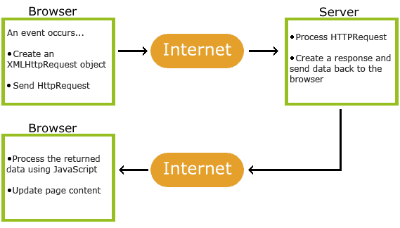
How AJAX Works

Slide 43
1. An event occurs in a web page (the page is loaded, a button is clicked)
2. An XMLHttpRequest object is created by JavaScript
3. The XMLHttpRequest object sends a request to a web server
4. The server processes the request
5. The server sends a response back to the web page
6. The response is read by JavaScript
7. Proper action (like page update) is performed by JavaScript

Slide 44
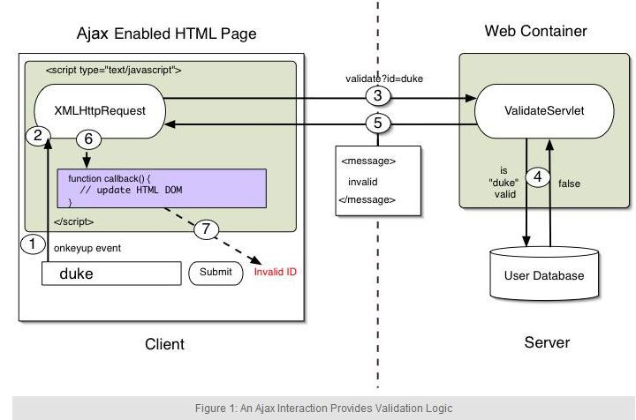

Slide 45
Based on Internet Standards
XHTML/HTML and CSS
To display the data
JavaScript (XMLHttpRequest calls)
To exchange data asynchronously with the server
XML
To tranfer the data
DOM (document object model)
To navigate the hierarchy of X/HTML elements

Slide 46
X/HTML and CSS
Elements are identified in the X/HTML code that will be worked with by the JavaScript
These provide the visual layout and structure for how the XML data will be displayed (performed on the client machine)
CSS provides the styling

Slide 47
JavaScript/XMLHttpRequest
Provides connection between the X/HTML element(s) and how they behave
Sends XMLHttpRequests on demand when the user creates events
Handles events both from the user and the replies from the server
Can parse XML data and map it to data objects needed in the JavaScript
Updates the X/HTML elements as needed

Slide 48
XML
Provides format for data transfer between the JavaScript and the server

Slide 49
DOM
Two DOMs involved
One for the elements in the X/HTML
One for the elements in the XML file
Defines the logical structure of the documents
Can be used by any programming language
Used for navigating around the tree structure
Provides quick access for changing/modifying elements

Slide 50
XMLHttpRequest
Object used for fetching/returning data
Can be synchronous or asynchronous—AJAX uses it asynchronously
Allows the web pages to get more data from the server incrementally and asynchronously while the user is doing other things
Examples are Gmail, which continuously asks the server for new mail and Google Maps, which update only the new parts of a map when the user mouses or clicks on a new point

Slide 51
Advantages
Interactivity
Asynchronous transmission of data back and forth
Bandwidth usage
Smaller payload
Encourages modularization
Function, data sources, structure and style
Allows non-related technologies to work together (server-side languages, databases, client-side languages, etc.)

Slide 52
Disadvantages
Difficult to debug because it is asynchronous
Search engines can’t index/optimize
Browsers handle XHRs differently—Internet Explorer didn’t have a native one till version 7 (presently on version 8)
Back button and bookmarks may not work as expected
May experience response time/latency problems if there are many frequent updates

Slide 53
Uses for AJAX
Real-time form data validation when server-side information is required
Autocompletion (again when server-side info from a database, for example, is needed)
Sophisticated user interface controls and effects such as progress bars
Getting current data without reloading a full page

Slide 54
AJAX - The XMLHttpRequest Object
The keystone of AJAX is the XMLHttpRequest object.
The XMLHttpRequest Object
All modern browsers support the XMLHttpRequest object.
The XMLHttpRequest object can be used to exchange data with a web server behind the scenes. This means that it is possible to update parts of a web page, without reloading the whole page.
Create an XMLHttpRequest Object
All modern browsers (Chrome, Firefox, IE7+, Edge, Safari, Opera) have a built-in XMLHttpRequest object.
Syntax for creating an XMLHttpRequest object:
variable = new XMLHttpRequest();
Example
if (window.XMLHttpRequest) { // code for modern browsers xmlhttp = new XMLHttpRequest(); } else { // code for old IE browsers xmlhttp = new ActiveXObject("Microsoft.XMLHTTP"); }

Slide 55
XMLHttpRequest Object Methods
Method | Description
new XMLHttpRequest() | Creates a new XMLHttpRequest object
abort() | Cancels the current request
getAllResponseHeaders() | Returns header information
getResponseHeader() | Returns specific header information
open(method, url, async, user, psw) | Specifies the request method: the request type GET or POST url: the file location async: true (asynchronous) or false (synchronous) user: optional user name psw: optional password
send() | Sends the request to the server Used for GET requests
send(string) | Sends the request to the server. Used for POST requests
setRequestHeader() | Adds a label/value pair to the header to be sent

Slide 56
XMLHttpRequest Object Properties
Property | Description
onreadystatechange | Defines a function to be called when the readyState property changes
readyState | Holds the status of the XMLHttpRequest. 0: request not initialized 1: server connection established 2: request received 3: processing request 4: request finished and response is ready
responseText | Returns the response data as a string
responseXML | Returns the response data as XML data
status | Returns the status-number of a request 200: "OK" 403: "Forbidden" 404: "Not Found" For a complete list go to the Http Messages Reference
statusText | Returns the status-text (e.g. "OK" or "Not Found")

Slide 57
AJAX - Send a Request To a Server
The XMLHttpRequest object is used to exchange data with a server.
Send a Request To a Server
To send a request to a server, we use the open() and send() methods of the XMLHttpRequest object:
xhttp.open("GET", "ajax_info.txt", true); xhttp.send();

Slide 58
AJAX - Server Response
The onreadystatechange Property
The readyState property holds the status of the XMLHttpRequest.
The onreadystatechange property defines a function to be executed when the readyState changes.
The status property and the statusText property holds the status of the XMLHttpRequest object.

Slide 59
AJAX XML Example
AJAX can be used for interactive communication with an XML file.
Example Explained
When a user clicks on the "Get CD info" button above, the loadDoc() function is executed.
The loadDoc() function creates an XMLHttpRequest object, adds the function to be executed when the server response is ready, and sends the request off to the server.
When the server response is ready, an HTML table is built, nodes (elements) are extracted from the XML file, and it finally updates the element "demo" with the HTML table filled with XML data:
function loadDoc() { var xhttp = new XMLHttpRequest(); xhttp.onreadystatechange = function() { if (this.readyState == 4 && this.status == 200) { myFunction(this); } }; xhttp.open("GET", "cd_catalog.xml", true); xhttp.send(); }

Slide 60
function myFunction(xml) { var i; var xmlDoc = xml.responseXML; var table="<tr><th>Artist</th><th>Title</th></tr>"; var x = xmlDoc.getElementsByTagName("CD"); for (i = 0; i <x.length; i++) { table += "<tr><td>" + x[i].getElementsByTagName("ARTIST")[0].childNodes[0].nodeValue + "</td><td>" + x[i].getElementsByTagName("TITLE")[0].childNodes[0].nodeValue + "</td></tr>"; } document.getElementById("demo").innerHTML = table; }

Slide 61
AJAX PHP Example
<html> <body> <p><b>Start typing a name in the input field below:</b></p> <p>Suggestions: <span id="txtHint"></span></p> <form> First name: <input type="text" onkeyup="showHint(this.value)"> </form> <script> function showHint(str) { if (str.length == 0) { document.getElementById("txtHint").innerHTML = ""; return; } else { var xmlhttp = new XMLHttpRequest(); xmlhttp.onreadystatechange = function() { if (this.readyState == 4 && this.status == 200) { document.getElementById("txtHint").innerHTML = this.responseText; } }; xmlhttp.open("GET", "gethint.php?q=" + str, true); xmlhttp.send(); } } </script> </body> </html>

Slide 62
AJAX Database Example
AJAX can be used for interactive communication with a database.
Example Explained - The showCustomer() Function
When a user selects a customer in the dropdown list above, a function called showCustomer() is executed. The function is triggered by the onchange event:
showCustomer
function showCustomer(str) { var xhttp; if (str == "") { document.getElementById("txtHint").innerHTML = ""; return; } xhttp = new XMLHttpRequest(); xhttp.onreadystatechange = function() { if (this.readyState == 4 && this.status == 200) { document.getElementById("txtHint").innerHTML = this.responseText; } }; xhttp.open("GET", "getcustomer.php?q="+str, true); xhttp.send(); }
The showCustomer() function does the following:
Check if a customer is selected Create an XMLHttpRequest object Create the function to be executed when the server response is ready Send the request off to a file on the server Notice that a parameter (q) is added to the URL (with the content of the dropdown list)

Slide 63
Rails on Ajax
AJAX stands for Asynchronous Javascript and XML. It is a mixture of several technologies and is an important part of Rails application. It allows client side changes without reloading the page.
Let us see the working of a normal web server. On typing a web address and clicking on search, the browser makes a request to the server. To assemble the searched page, it fetches all associated assets like JavaScript files, images and stylesheets. On clicking a link, same process is followed. This is called 'request response cycle'.
JavaScript makes request to the server, and parse the response. It can update information on the page. On combining these two abilities, a web page can be made with JavaScript that can update just a part of itself, without loading full page from the server. This technique is called AJAX.

Slide 64
By default Rails ships with CoffeeScript.
Let us see an example code to make Ajax request using the jQuery library
$.ajax(url: "/test").done (html) ->
$("#results").append html
The above code fetches data from "/test", then appends the result to the div with an id of results.
Unobtrusive JavaScript
To handle attached JavaScript to the DOM, Rails uses "Unobtrusive JavaScript" technique. This is considered as the best technique within the frontend community.
This is called 'Unobtrusive' JavaScript because we do not mix JavaScript code into HTML. With this, we can easily add behavior to any link by adding data attribute. Lot of benefits add up like the entire JavaScript is served on every page, it means it'll get downloaded on the first page load and then can be cached on every page after that.

Slide 65
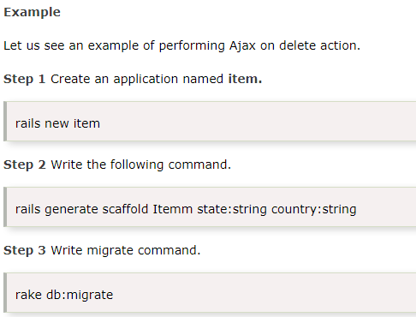

Slide 66
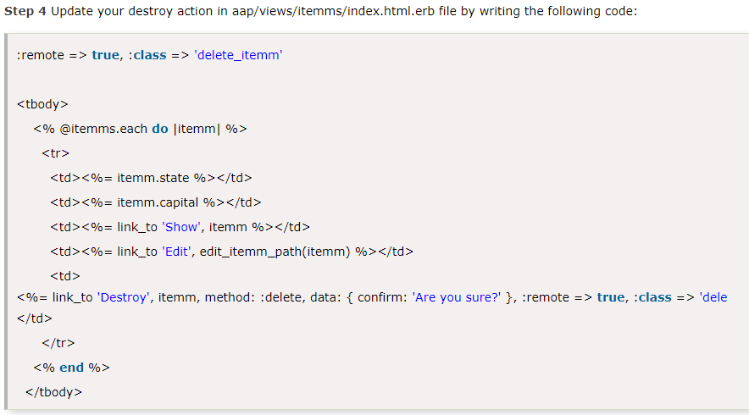

Slide 67
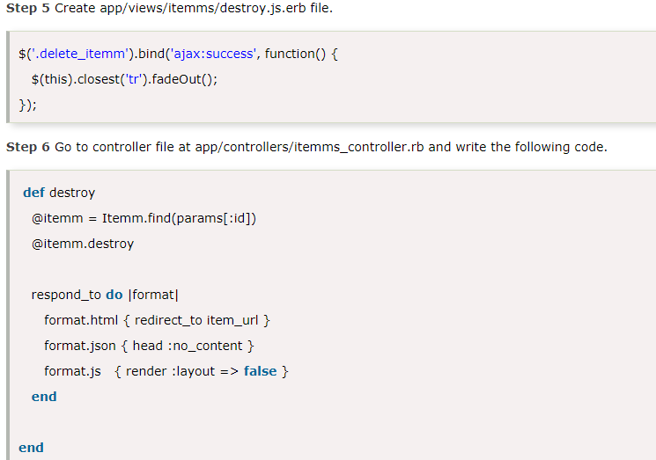

Slide 68
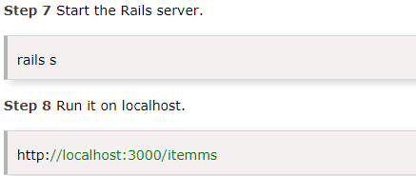
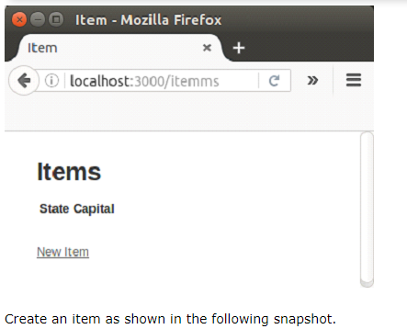

Slide 69
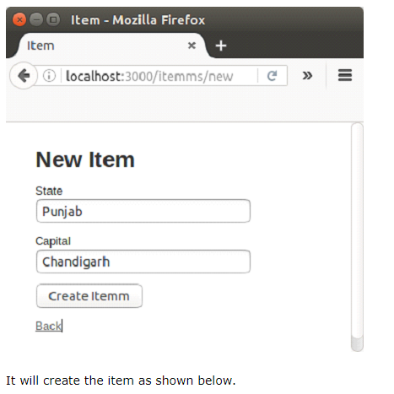

Slide 70
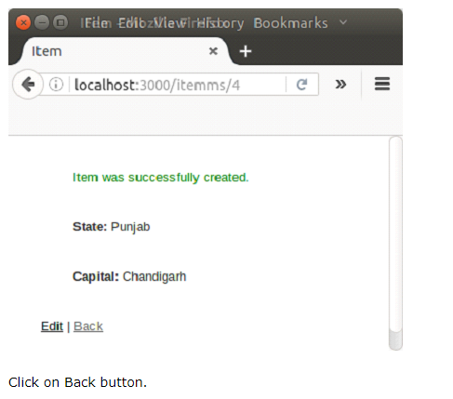

Slide 71
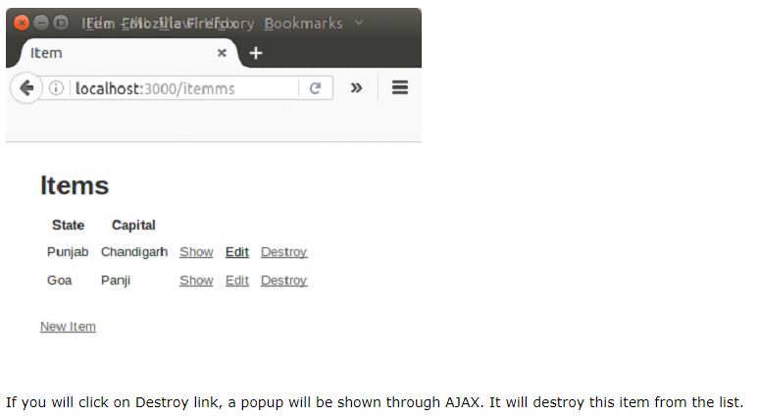

Slide 72
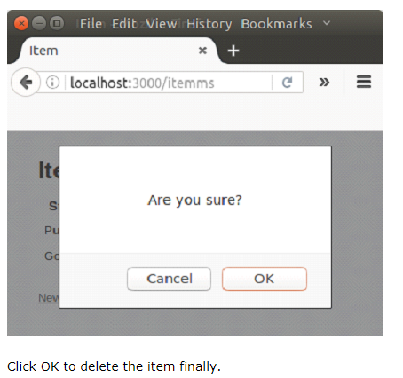

Slide 73
