Slide 1
UNIT - 3
by
Ranjani.B,
AP/CSE, EGSPEC

Slide 2
Contents
Origin and Use of Perl- Scalars and their Operations – Assignment Statements and Simple Input and Output – Control Statements- Fundamentals of Arrays – Hashes References- Functions- Pattern Matching – File Input and Output – Simple programs in Perl -Using Perl for CGI Programming.

Slide 3
Perl Introduction
Perl is a programming language which was originally developed for script manipulation. But now Perl is used for a variety of purpose including web development, GUI development, system administration and many more. It is a stable, cross platform programming language.
For web development, Perl CGI is used. CGI is the gateway which interacts with the web browser and Perl in a system.
Its typical use is extracting information from a text file and printing out report for converting a text file into another form. This is because it got its name after the expression, "Practical Extraction and Report Language".
Programs written in Perl are called Perl scripts, whereas system programs to execute Perl scripts are called Perl program.
Perl is an interpreted language. When a Perl program run, it is first compiled into a byte code, then it is converted into machine instructions. So writing something in Perl instead of C saves your time.
Website to install PERL : “http://padre.perlide.org/”

Slide 4
Perl History
Perl was developed by Larry Wall in 1987 as a scripting language to make report processing easier.
It was first released with version 1.0 on December 18, 1987.
Perl 2, released in 1988 adding a much better regular expression engine.
Perl 3, released in 1989 adding support for binary data streams.
Perl 4, released in 1991 with a better documentation than earlier.
Perl 5, released on October 17, 1994. It added many new features to its last version like objects, variables, references and modules.
The latest version 5.24 is released on May 9, 2016.

Slide 5
Perl Features
Perl supports both procedural and object-oriented programming.
It is easily extendible as it supports 25,000 open source modules.
It supports Unicode.
It includes powerful tools to process text to make it compatible with mark-up languages like HTML, XML.
Its database integration interface , DBI supports third-party databases including Oracle, Sybase, Postgres, MySQL and others.
It is embeddable in other systems such as web servers and database servers.
It is open source software licensed under GNU.
Many frameworks are written in Perl.
It can handle encrypted web data including e-commerce transactions.
It is a cross platform language.

Slide 6
Where is PERL used
The power of Perl can be implemented in many fields. The most popular use of Perl is in Web development.
Perl is also used to automate many tasks in the Web servers and other administration jobs, it can automatically generate emails and clean up systems.
Perl is still used for its original purpose i.e. extracting data and generating reports.
Perl has become a popular language used in web development, networking and bioinformatics too.
Apart from all this perl can also be used for CGI programming.
Perl can also be utilized for image creation & manipulation.
Perl is also known for implementation of OOP(object oriented programming) practices and supports all forms of inheritance (simple, multiple & diamond), polymorphism and encapsulation.
Perl is flexible enough to support Procedural as well as OOP practices simultaneously.

Slide 7
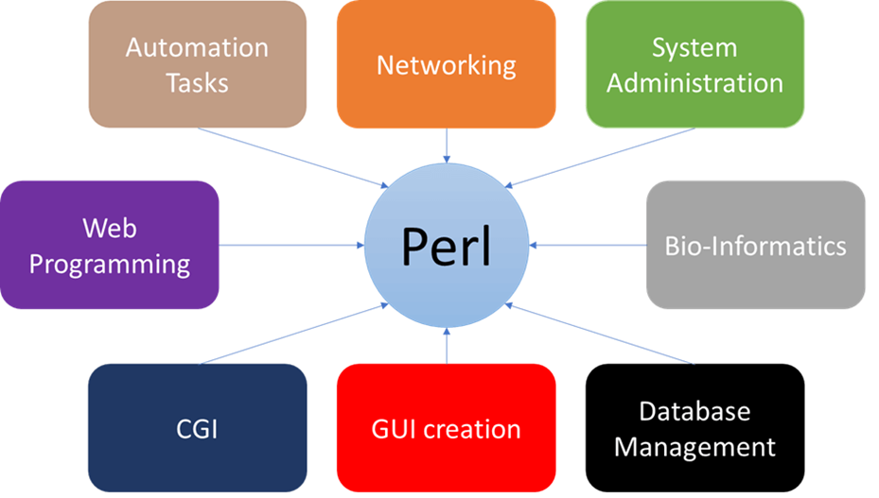

Slide 8
Use of Perl
Perl is very easy to learn, especially if you have a background in computer programming. Perl was designed to be easy for humans to write and understand rather than making it easy for processing by computers. It uses regular expressions.
Perl is extremely portable. It can run on any operating system that has Perl interpreter installed, so it is platform independent.
Small specific tasks in Perl become very easy and quick.
Perl is very good at text processing, File handling and output reporting.
It is free to use.

Slide 9
Pros & Cons in PERL
PROS
Compared to other Programming languages Perl is most powerful for text handling and Parsing.
This is an interpreted language with fast execution time as there is no need to compile a Perl script.
Simple and easy to program and understand.
It is object oriented.
Used in Web development for mostly Payment Gateways.
Used in Automation and to test most of the Network and Storage related stuff.
CONS
There is minimal GUI support as compared to other Programming languages.
You need to refer to complex library modules which are not so easy to understand.
Understanding complex Patterns requires experience.

Slide 10
Perl Example 1
Example:
!/usr/bin/perl
# Print a message
print "Hello World! with Perl\n";
#!/usr/local/bin/perl, tells where to find the Perl compiler on your system.
Perl statements end with semicolon (;)
The (\n) is used to denote a new line.
As it is a string, it will be enclosed in double quotes ("").
And finally 'print' will display it on the screen.
Perl is case-sensitive.
Saving File:
Save the file with (.pl) extension.

Slide 11
Perl print() and say()
The say() is not supported by the older perl versions.
It acts like print() with only difference that it automatically adds a new line at the end without mentioning (\n).
Note: you need to mention the version in your script to use the say() function.

Slide 12
Comments in Perl
Comments in any programming language are friends of developers.
Comments can be used to make program user friendly and they are simply skipped by the interpreter without impacting the code functionality.
For example:
# This is a single line comment
print "Hello, world\n“;
Multi-line comments start with = and with the =cut statement.
=begin comment.This is another comment. And it spans multiple lines! =cut

Slide 13
Single and Double Quotes in Perl
#!/usr/bin/perl $a = 10;
print "Value of a = $a\n";
print 'Value of a = $a\n';
This will produce the following result −
Value of a = 10
Value of a = $a\n
Only double quotes interpolate variables and special characters such as newlines \n, whereas single quote does not interpolate any variable or special character.

Slide 14
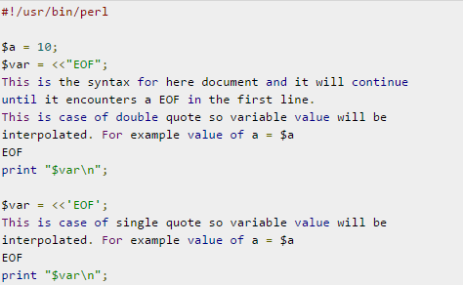
"Here" Documents
You can store or print multiline text with a great comfort. Even you can make use of variables inside the "here" document. Below is a simple syntax, check carefully there must be no space between the << and the identifier.
An identifier may be either a bare word or some quoted text like we used EOF below. If identifier is quoted, the type of quote you use determines the treatment of the text inside the here document, just as in regular quoting. An unquoted identifier works like double quotes.

Slide 15
Scalars and Their Operations
Scalar variables start with $
Scalar variables hold strings or numbers, and they are interchangeable
When you first use (declare) a variable use the my keyword (not necessary) to indicate the variable’s scope.
Name must begin with a letter; any number of letters, digits, or underscore characters can follow
Names are case sensitive
Examples:
my $priority = 9;
my $priority = “A”;

Slide 16
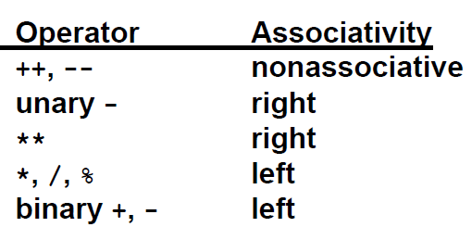
Scalars and Their Operations (continued)
Numeric Operators
- Like those of C, Java, etc.

Slide 17
Scalars and Their Operations (continued)
String Operators
- Concatenation - denoted by a period
e.g., If the value of $dessert is "apple", the value of
$dessert . " pie" is "apple pie"
- Repetition - denoted by x
e.g., If the value of $greeting is "hello ", the value of
$greeting x 3 is "hello hello hello “
String Functions
- Functions and operators are closely related in Perl
e.g., if cube is a predefined function, it can be called with either cube(x) or cube x

Slide 18
Scalars and Their Operations (continued)

Slide 19
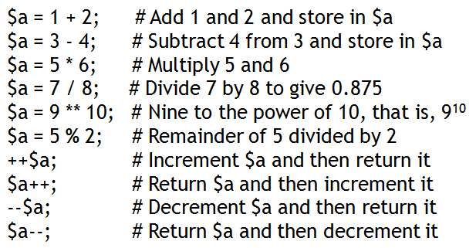
Arithmetic in Perl

Slide 20
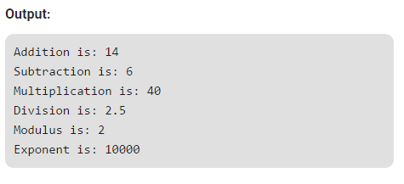
# Perl Program to illustrate the Arithmetic Operators
# Operands
$a = 10;
$b = 4;
# using arithmetic operators
print "Addition is: ", $a + $b, "\n";
print "Subtraction is: ", $a - $b, "\n" ;
print "Multiplication is: ", $a * $b, "\n";
print "Division is: ", $a / $b, "\n";
print "Modulus is: ", $a % $b, "\n";
print "Exponent is: ", $a ** $b, "\n";

Slide 21
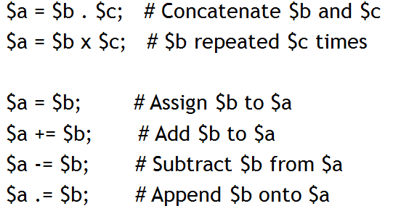
String and assignment operators
You sometimes may need to group terms
Use parentheses ()
(5-6)*2 is not 5-(6*2)

Slide 22
Assignment Operators
Assignment operators are used to assigning a value to a variable. The left side operand of the assignment operator is a variable and right side operand of the assignment operator is a value.
Different types of assignment operators are shown below:
“=”(Simple Assignment) : This is the simplest assignment operator. This operator is used to assign the value on the right to the variable on the left. Example :$a = 10; $b = 20;
“+=”(Add Assignment) : This operator is combination of ‘+’ and ‘=’ operators. This operator first adds the current value of the variable on left to the value on the right and then assigns the result to the variable on the left. Example :($a += $b) can be written as ($a = $a + $b) If initially value stored in a is 5. Then ($a += 6) = 11.

Slide 23
Assignment Operators (continued)
“-=”(Subtract Assignment) : This operator is combination of ‘-‘ and ‘=’ operators. This operator first subtracts the current value of the variable on left from the value on the right and then assigns the result to the variable on the left. Example :($a -= $b) can be written as ($a = $a - $b) If initially value stored in a is 8. Then ($a -= 6) = 2.
“*=”(Multiply Assignment) : This operator is combination of ‘*’ and ‘=’ operators. This operator first multiplies the current value of the variable on left to the value on the right and then assigns the result to the variable on the left. Example : ($a *= $b) can be written as ($a = $a * $b) If initially value stored in a is 5. Then ($a *= 6) = 30.

Slide 24
Assignment Operators (continued)
“/=”(Division Assignment) : This operator is combination of ‘/’ and ‘=’ operators. This operator first divides the current value of the variable on left by the value on the right and then assigns the result to the variable on the left. Example :($a /= $b) can be written as ($a = $a / $b) If initially value stored in a is 6. Then ($a /= 2) = 3.
“%=”(Modulus Assignment) : This operator is combination of ‘%’ and ‘=’ operators. This operator first modulo the current value of the variable on left by the value on the right and then assigns the result to the variable on the left. Example :($a %= $b) can be written as ($a = $a % $b) If initially value stored in a is 6. Then ($a %= 2) = 0.
“**=”(Exponent Assignment) : This operator is combination of ‘**’ and ‘=’ operators. This operator first exponent the current value of the variable on left by the value on the right and then assigns the result to the variable on the left. Example :($a **= $b) can be written as ($a = $a ** $b) If initially value stored in a is 6. Then ($a **= 2) = 36.

Slide 25
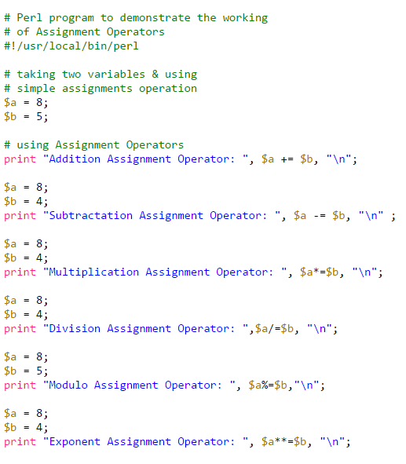

Slide 26
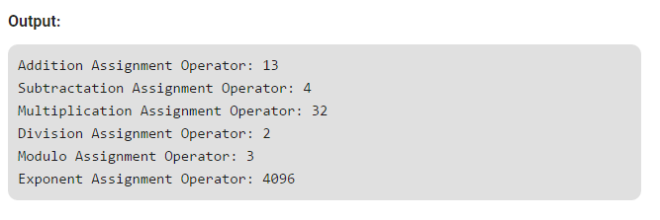

Slide 27
Control Statements
Perl is an iterative language in which control flows from the first statement in the program to the last statement unless something interrupts. Some of the things that can interrupt this linear flow are conditional branches and loop structures.
statement block
Statement blocks provide a mechanism for grouping statements that are to be executed as a result some expression being evaluated. They are used in all of the control structures discussed below. Statement blocks are designated by pairs of curly braces.
Syntax: {
stmt_1;
stmt_2;
stmt_3;
}

Slide 28
Control Statements (Continued)
if/elseif/else statement
Form:
if (EXPR) BLOCK elseif (EXPR) BLOCK . . . else BLOCK
Syntax:
if (expression_A)
{
A_true_stmt_1;
A_true_stmt_2;
}
elseif (expression_B)
{
B_true_stmt_1;
B_true_stmt_2;
}
else
{
false_stmt_1;
false_stmt_2;
}
if statement
Form: if (EXPR) BLOCK
Syntax:
if (expression)
{
true_stmt_1;
true_stmt_2;
true_stmt_3;
}
if/else statement
Form: if (EXPR) BLOCK else BLOCK
Syntax:
if (expression)
{
true_stmt_1;
true_stmt_2;
true_stmt_3;
}
else
{
false_stmt_1;
false_stmt_2;
false_stmt_3;
}

Slide 29
while statement - Repeats a statement or group of statements while a given condition is true. It tests the condition before executing the loop body.
Form: LABEL: while (EXPR) BLOCK
The LABEL in this and the following control structures is optional. In addition to description, it also provides function in the quasi-goto statements: last, next, and redo. Perl conventional practice calls for labels to be expressed in uppercase to avoid confusion with variables or key words.
Syntax:
ALABEL: while (expression)
{
stmt_1;
stmt_2;
stmt_3;
}
Control Statements (Continued)

Slide 30
last operator - Terminates the loop statement and transfers execution to the statement immediately following the loop.
The last operator, as well as the next and redo operators that follow, apply only to loop control structures. They cause execution to jump from where they occur to some other position, defined with respect to the block structure of the encompassing control structure. Thus, they function as limited forms of goto statements.
Last causes control to jump from where it occurs to the first statement following the enclosing block.
Syntax:
ALABEL: while (expression)
{
stmt_1;
stmt_2;
last;
stmt_3;
} # last jumps to here

Slide 31
If last occurs within nested control structures, the jump can be made to the end of an outer loop by adding a label to that loop and specifying the label in the last statement.
Syntax:
ALABEL: while (expression)
{
stmt_1;
stmt_2;
BLABEL: while (expression)
{
stmt_a;
stmt_b;
last ALABEL;
stmt_c;
}
stmt_3;
} # last jumps to here

Slide 32
next operator - Causes the loop to skip the remainder of its body and immediately retest its condition prior to reiterating.
The next operator is similar to last except that execution jumps to the end of the block, but remains inside the block, rather than exiting the block. Thus, iteration continues normally.
Syntax:
ALABEL: while (expression)
{
stmt_1;
stmt_2;
next;
stmt_3;
# next jumps to here
}
As with last, next can be used with a label to jump to an outer designated loop.

Slide 33
redo operator - The redo command restarts the loop block without evaluating the conditional again. The continue block, if any, is not executed.
The redo operator is similar to next except that execution jumps to the top of the block without re-evaluating the control expression.
Syntax:
ALABEL: while (expression)
{
# redo jumps to here
stmt_1;
stmt_2;
redo;
stmt_3;
}
As with last, next can be used with a label to jump to an outer designated loop.

Slide 34
Control Statements (Continued)
until statement - Repeats a statement or group of statements until a given condition becomes true. It tests the condition before executing the loop body.
Form: LABEL: until (EXPR) BLOCK
Syntax:
ALABEL: until (expression)
{ # while not
stmt_1;
stmt_2;
}
for statement - Executes a sequence of statements multiple times and abbreviates the code that manages the loop variable
Form: LABEL: for (EXPR; EXPR; EXPR) BLOCK
Syntax:
ALABEL: for (initial exp; test exp; increment exp) # e.g., ($i=1; $i<5; $i++)
{
stmt_1;
stmt_2;
}

Slide 35
foreach statement - The foreach loop iterates over a normal list value and sets the variable VAR to be each element of the list in turn.
Form: LABEL: foreach VAR (EXPR) BLOCK
Syntax:
ALABEL: foreach $i (@aList)
{
stmt_1;
stmt_2;
stmt_3;
}
Example:
# Perl program to illustrate # the foreach loop # Array @data = (‘HI’, ‘HELLO’, ‘WELCOME’); # foreach loop foreach $word (@data) { print $word }

Slide 36
Switch Statement
It is used to execute the code from multiple conditions. There is no case or switch statement in perl. Instead we use 'when' in place of case and 'given' in place of switch.
Syntax:
given (expression)
{
when (condition)
{
statement(s);
}
when (condition)
{
statement(s);
}
. . .
default
{
statement(s);
}
}

Slide 37
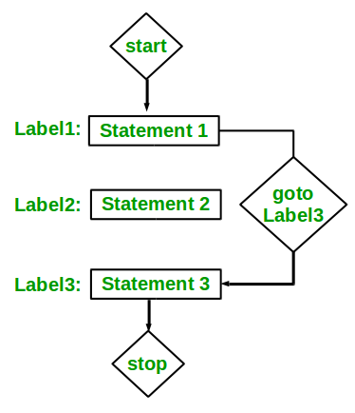
goto statement
The goto statement in perl is a jump statement which is sometimes also referred to as unconditional jump statement. The goto statement can be used to jump from anywhere to anywhere within a function.
Syntax:
LABEL:
Statement 1;
Statement 2;
. . . . .
Statement n;
goto LABEL;
goto statement in Perl is of three forms- Label, Expression, and Subroutine.
Label: It will simply jump to the statement marked with the LABEL, and will continue the execution from that statement.
Expression: In this form, there will be an expression that will return a Label name after evaluation and goto will make it jump to the labeled statement.
Subroutine: goto will transfer the compiler to the subroutine of the given name from the currently running subroutine.

Slide 38
Example for goto statement:
# Perl program to print numbers # from 1 to 10 using goto statement # function to print numbers from 1 to 10 sub printNumbers() { my $n = 1; label: print "$n "; $n++; if ($n <= 10) { goto label; } } # Driver Code printNumbers();
Output:
1 2 3 4 5 6 7 8 9 10

Slide 39
Example for goto statement using Expression:
An expression can also be used to give a call to a specific label and pass the execution control to that label. This expression when passed to the goto statement, evaluates to generate a label name, and further execution is continued from that statement defined by that label name.
Example:
# Defining two strings which contain label name in parts $a = "lab"; $b = "el"; # function to print numbers from 1 to 10 sub printNumbers() { my $n = 1; label: print "$n "; $n++; if ($n <= 10) { # Passing Expression to label name goto $a.$b; } } # Driver Code printNumbers();

Slide 40
Example for goto statement using subroutine:
A subroutine can also be called with the use of the goto statement. This subroutine is called from within another subroutine or individually based on its use. It holds the work that is to be performed next to the calling statement. This method can be used to call a function recursively to print a series or a range of characters.
Example:
# Perl program to print numbers from 1 to 10 using goto statement # function to print numbers from 1 to 10 sub label { print "$n "; $n++; if($n <= 10) { goto &label; } } # Driver Code my $n = 1; label();

Slide 41
Continue Statement
A continue BLOCK, is always executed just before the conditional is about to be evaluated again. A continue statement can be used with while and foreach loops. A continue statement can also be used alone along with a BLOCK of code in which case it will be assumed as a flow control statement rather than a function.
Syntax
continue
{
statement(s);
}
foreach $a (@listA)
{
statement(s);
}
continue
{
statement(s);
}
while(condition)
{
statement(s);
}
continue
{
statement(s);
}

Slide 42
Perl Array
A Perl array variable stores an ordered list of scalar values.
Array variables are preceeded by an "at" (@) sign.
To refer a single element of Perl array, variable name will be preceded with dollar ($) sign followed by index of element in the square bracket.
Syntax:
@arrayName = (element1, element2, element3..);
Perl Simple Array Example
#!/usr/bin/perl
@num = (2015, 2016, 2017);
@string = ("One", "Two", "Three");
print "$num[0]\n";
print "$num[1]\n";
print "$num[2]\n";
print "$string[0]\n";
print "$string[1]\n";
print "$string[2]\n";
Output:
2015
2016
2017
One
Two
Three
In the above example, we have defined two arrays, one with number element and other with string element. Both arrays are printed with their index elements.

Slide 43
Perl Simple Array Example-2
#!/usr/bin/perl
@ages = (25, 30, 40);
@names = ("John Paul", "Lisa", "Kumar");
print "\$ages[0] = $ages[0]\n";
print "\$ages[1] = $ages[1]\n";
print "\$ages[2] = $ages[2]\n";
print "\$names[0] = $names[0]\n";
print "\$names[1] = $names[1]\n";
print "\$names[2] = $names[2]\n";
Here we have used the escape sign (\) before the $ sign just to print it. Other Perl will understand it as a variable and will print its value.
Output:
$ages[0] = 25
$ages[1] = 30
$ages[2] = 40
$names[0] = John Paul
$names[1] = Lisa
$names[2] = Kumar

Slide 44
Array Creation
Array variables are prefixed with the @ sign and are populated using either parentheses or the qw operator. For Example,
@array = (1, 2, 'Hello');
@array = qw/This is an array/;
The second line uses the qw// operator, which returns a list of strings, separating the delimited string by white space. In this example, this leads to a four-element array; the first element is 'this' and last (fourth) is 'array'. This means that you can use different lines as follows −
@days = qw/Monday
Tuesday
...
Sunday/;
You can also populate an array by assigning each value individually as follows −
$array[0] = 'Monday';
...
$array[6] = 'Sunday';

Slide 45
Accessing Array Elements
When accessing individual elements from an array, you must prefix the variable with a dollar sign ($) and then append the element index within the square brackets after the name of the variable. For example −
This will produce the following result −
#!/usr/bin/perl
@days = qw/Mon Tue Wed Thu Fri Sat Sun/;
print "$days[0]\n";
print "$days[1]\n";
print "$days[2]\n";
print "$days[6]\n";
print "$days[-1]\n";
print "$days[-7]\n";
Mon
Tue
Wed
Sun
Sun
Mon
Array indices start from zero, so to access the first element you need to give 0 as indices. You can also give a negative index, in which case you select the element from the end, rather than the beginning, of the array. This means the following −
print $days[-1]; # outputs Sun
print $days[-7]; # outputs Mon

Slide 46
Sequential Number Arrays
Perl offers a shortcut for sequential numbers and letters. Rather than typing out each element when counting to 100 for example, we can do something like as follows −
#!/usr/bin/perl
@var_10 = (1..10);
@var_20 = (10..20);
@var_abc = (a..z);
print "@var_10\n"; # Prints number from 1 to 10
print "@var_20\n"; # Prints number from 10 to 20
print "@var_abc\n"; # Prints number from a to z
Here double dot (..) is called range operator. This will produce the following result −
1 2 3 4 5 6 7 8 9 10
10 11 12 13 14 15 16 17 18 19 20
a b c d e f g h i j k l m n o p q r s t u v w x y z

Slide 47
Perl Array Size or Length
The size of an array is determined with scalar context on the array. The returned value will be always one greater than the largest index. In short the size of an array will be ($#array + 1). Here, $#array is the maximum index of the array.
@array = (you, me, us);
$array[5] = 4;
$size = @array;
$index_max = $#array;
print "Size: $size\n";
print "Maximum Index: $index_max\n";
Output:
Size: 6
Maximum Index: 5
In the output, there are only three elements containing information, but the give array has total 5 elements.

Slide 48
Perl Array Functions
You can add or remove an element from an array using some array functions.
We'll discuss following array Perl functions:
Push
Pop
Shift
Unshift
1) Push on Array
The push array function appends a new element at the end of the array.
Example:
@array = ("pink", "red", "blue");
push @array, "orange";
print "@array\n";
Output:
pink red blue orange
In the above program, "orange" element is added at the end of the array.

Slide 49
2) Pop on Array
The pop array function removes the last element from the array.
Example:
@array = ("pink", "red", "blue");
pop @array;
print "@array\n";
Output:
pink red
In the above program, "blue" element is removed from the end of the array.
3) Shift on Array
The shift array function removes the left most element of array and thus shorten the array by 1.
Example:
@array = ("pink", "red", "blue");
shift @array;
print "@array\n";
Output:
red blue
In the above program, "pink" is removed from the array.

Slide 50
4) Unshift on Array
The unshift array function adds a new element at the start of the array.
Example:
@array = ("pink", "red", "blue");
unshift @array, "orange";
print "@array\n";
Output:
orange pink red blue
In the above program, "orange" is added at the start of the array.
Slicing Array Elements
You can also extract a "slice" from an array - that is, you can select more than one item from an array in order to produce another array.
This will produce the following result −
#!/usr/bin/perl
@days = qw/Mon Tue Wed Thu Fri Sat Sun/;
@weekdays = @days[3,4,5];
print "@weekdays\n";
Thu Fri Sat
The specification for a slice must have a list of valid indices, either positive or negative, each separated by a comma.

Slide 51
For speed, you can also use the .. range operator −
#!/usr/bin/perl
@days = qw/Mon Tue Wed Thu Fri Sat Sun/;
@weekdays = @days[3..5];
print "@weekdays\n";
This will produce the following result −
Thu Fri Sat
Replacing Array Elements
Now we are going to introduce one more function called splice(), which has the following syntax −
splice @ARRAY, OFFSET [ , LENGTH [ , LIST ] ]
This function will remove the elements of @ARRAY designated by OFFSET and LENGTH, and replaces them with LIST, if specified. Finally, it returns the elements removed from the array.
Following is the example −

Slide 52
#!/usr/bin/perl
@nums = (1..20);
print "Before - @nums\n";
splice(@nums, 5, 5, 21..25);
print "After - @nums\n";
This will produce the following result −
Before - 1 2 3 4 5 6 7 8 9 10 11 12 13 14 15 16 17 18 19 20
After - 1 2 3 4 5 21 22 23 24 25 11 12 13 14 15 16 17 18 19 20
Here, the actual replacement begins with the 6th number after that five elements are then replaced from 6 to 10 with the numbers 21, 22, 23, 24 and 25.
Perl Strings to Arrays, split()
With the help of split() function, we can split a string into array of strings and returns it.
Syntax :
split [ PATTERN [ , EXPR [ , LIMIT ] ] ]

Slide 53
#!/usr/bin/perl
# define Strings
$var_string = "Rain-Drops-On-Roses-And-Whiskers-On-Kittens";
$var_names = "Larry,David,Roger,Ken,Michael,Tom";
# transform above strings into arrays.
@string = split('-', $var_string);
@names = split(',', $var_names);
print "$string[3]\n"; # This will print Roses
print "$names[4]\n"; # This will print Michael
This will produce the following result −
Roses
Michael

Slide 54
Perl Arrays to Strings, join()
The join() function is used to combine arrays to make a string. It combines the separate arrays into one string and returns it.
#!/usr/bin/perl
# define Strings
$var_string = "Rain-Drops-On-Roses-And-Whiskers-On-Kittens";
$var_names = "Larry,David,Roger,Ken,Michael,Tom";
# transform above strings into arrays.
@string = split('-', $var_string);
@names = split(',', $var_names);
$string1 = join( '-', @string );
$string2 = join( ',', @names );
print "$string1\n";
print "$string2\n";
This will produce the following result −
Rain-Drops-On-Roses-And-Whiskers-On-Kittens
Larry,David,Roger,Ken,Michael,Tom

Slide 55
Perl Merging Two Arrays, merged()
Two arrays can be merged together using merged() function as a single string removing all the commas in between them.
Example:
#!/usr/bin/perl
@odd = (1,3,5);
@even = (2, 4, 6);
@numbers = (@odd, @even);
print "numbers = @numbers\n";
Output:
numbers = 1 3 5 2 4 6
In the above program, array1 and array2 are merged into one single string and then printed.
OR
#!/usr/bin/perl
@numbers = (1,3,(4,5,6));
print "numbers = @numbers\n";
numbers = 1 3 4 5 6

Slide 56
Perl Sorting Arrays, sort()
To sort an array, sort() array function is used. The sort() function sorts all the elements of an array according to the ASCII standard.
Example:
# defining array
@days = ("sun", "mon", "tue", "wed", "thu", "fri", "sat"); print "Original array: @days\n";
# sorting array
@days = sort(@days);
print "Sorted array: @days\n";
Output:
Original array: sun mon tue wed thu fri sat
Sorted array: fri mon sat sun thu tue wed
In the above program, we have printed both original and sorted array. This array is sorted in the alphabetical order.

Slide 57
Selecting Elements from Lists
The list notation is identical to that for arrays. You can extract an element from an array by appending square brackets to the list and giving one or more indices −
#!/usr/bin/perl
$var = (5,4,3,2,1)[4];
print "value of var = $var\n"
This will produce the following result −
value of var = 1
Similarly, we can extract slices, although without the requirement for a leading @ character −
#!/usr/bin/perl
@list = (5,4,3,2,1)[1..3];
print "Value of list = @list\n";
This will produce the following result −
Value of list = 4 3 2

Slide 58
Perl Array with Loops
Perl array elements can be accessed within a loop. Diferent types of loops can be used.
We will show array accessing with following loops:
foreach loop
for loop
while loop
until loop
Perl Array with foreach Loop
In foreach loop, the control variable is set over the elements of an array. Here, we have specified $i as the control variable and print it.
Output:
Example:
@num = qw(10 20 30 40 50);
foreach $i (@num) {
print "$i\n";
}
10
20
30
40
50

Slide 59
Perl Array with for Loop
A control variable will be passed in for loop as the index of the given array.
Example:
@num = qw(10 20 30 40 50);
for($i = 0; $i < 5; $i++){
print "@num[$i]\n";
}
Output:
10
20
30
40
50
Perl Array with until Loop
The until loop works like while loop, but they are opposite of each other. A while loop runs as long as a condition is true whereas an until loop runs as long as condition is false. Once the condition is false until loop terminates. The until loop can be written on the right hand side of the equation as an expression modifier.
Example:
@your_name = "John";
print "@your_name\n" until $i++ > 4;
Output:
John
John
John
John
John
In the above program, once $i is greater than 4 according to the condition, loop iteration stops.

Slide 60
Perl Multidimensional Array
Perl multidimensional arrays are arrays with more than one dimension. The multi dimensional array is represented in the form of rows and columns, also called Matrix.
They can not hold arrays or hashes, they can only hold scalar values. They can contain references to another arrays or hashes.
Perl Multidimensional Array Matrix Example
Here, we are printing a 3 dimensional matrix by combining three different arrays arr1, arr2 and arr3. These three arrays are merged to make a matrix array final.
Two for loops are used with two control variables $i and $j.
## Declaring arrays
my @arr1 = qw(0 10 0);
my @arr2 = qw(0 0 20);
my@arr3 = qw(30 0 0);
## Merging all the single dimensional arrays
my @final = (\@arr1, \@arr2, \@arr3);
print "Print Using Array Index\n";
for(my $i = 0; $i <= $#final; $i++){
# $#final gives highest index from the array
for(my $j = 0; $j <= $#final ; $j++){
print "$final[$i][$j] ";
}
print "\n";
}
Output:
Print Using Array Index
0 10 0
0 0 20
30 0 0

Slide 61
Perl Multidimensional Array Initialization and Declaration Example
In this example we are initializing and declaring a three dimensional Perl array .
@array = (
[1, 2, 3],
[4, 5, 6],
[7, 8, 9]
);
for($i = 0; $i < 3; $i++)
{
for($j = 0; $j < 3; $j++)
{
print "$array[$i][$j] ";
}
print "\n";
}
Output:
1 2 3
4 5 6
7 8 9

Slide 62
Perl Hashes
The hashes is the most essential and influential part of the perl language.
A hash is a group of key-value pairs. The keys are unique strings and values are scalar values.
Hashes are declared using my keyword. The variable name starts with a (%) sign.
Hashes are like arrays but there are two differences between them.
First arrays are ordered but hashes are unordered.
Second, hash elements are accessed using its value while array elements are accessed using its index value.
No repeating keys are allowed in hashes which makes the key values unique inside a hash. Every key has its single value.

Slide 63
Syntax for Perl hashes:
my %hashName = (
"key" => "value";
)
Perl Hash Accessing
To access single element of hash, ($) sign is used before the variable name. And then key element is written inside {} braces.
Example
my %capitals = (
"India" => "New Delhi",
"South Korea" => "Seoul",
"USA" => "Washington, D.C.",
"Australia" => "Canberra"
);
print"$capitals{'India'}\n";
print"$capitals{'South Korea'}\n";
print"$capitals{'USA'}\n";
print"$capitals{'Australia'}\n";
Output:
New Delhi
Seoul
Washington,D.C. Canberra

Slide 64
Perl Hash Indexing
Hashes are indexed using $key and $value variables. All the hash values will be printed using a while loop. As the while loop runs, values of each of these variables will be printed.
Example:
my %capitals = (
"India" => "New Delhi",
"South Korea" => "Seoul",
"USA" => "Washington, D.C.",
"Australia" => "Canberra"
);
# LOOP THROUGH IT
while (($key, $value) = each(%capitals)){
print $key.", ".$value."\n";
}
Output:
Australia, Canberra
India, New Delhi
USA, Washington, D.C.
South Korea, Seoul

Slide 65
Perl sorting Hash by key
You can sort a hash using either its key element or value element. Perl provides a sort() function for this. In this example, we'll sort the hash by its key elements
Example:
my %capitals = (
"India" => "New Delhi",
"South Korea" => "Seoul",
"USA" => "Washington, D.C.",
"Australia" => "Canberra"
);
# Foreach loop
foreach $key (sort keys %capitals) {
print "$key: $capitals{$key}\n";
}
Output:
Australia: Canberra
India: New Delhi
South Korea: Seoul
USA: Washington: D.C.
Look at the output, all the key elements are sorted alphabetically.

Slide 66
Perl sorting Hash by its value
Here we'll sort hash by its value elements.
Example:
my %capitals = (
"India" => "New Delhi",
"South Korea" => "Seoul",
"USA" => "Washington, D.C.",
"UK" => "London"
);
# Foreach loop
foreach $value (sort {$capitals{$a} cmp $capitals{$b} }
keys %capitals)
{
print "$value $capitals{$value}\n";
}
Output:
UK London
India New Delhi
South Korea Seoul
USA Washington D.C.
Look at the output, all the value elements are sorted alphabetically.

Slide 67
Perl Hash key Existence
Accessing a key-value pair from hash which doesn't exist will return error or warnings. To prevent from this, you can check whether a key exist or not in a hash with exists() function. It returns true if the key exists.
Example:
my %capitals = (
"India" => "New Delhi",
"South Korea" => "Seoul",
"USA" => "Washington, D.C.",
"Australia" => "Canberra"
);
if (exists($capitals{'India'}))
{
print "found the key\n";
}
Output:
found the key
The above output shows that the 'India' key exists in the 'capitals' hash.

Slide 68
Perl Hash Slices
If you want only some values from a hash, you can extract them and display as a list of values.
For this, you have to store them in an array variable with @ prefix as they will return a list of values and then print them.
Example:
my %capitals = (
"India" => "New Delhi",
"South Korea" => "Seoul",
"USA" => "Washington, D.C.",
"Australia" => "Canberra"
);
@array = @capitals{India, USA, Australia};
print "@array\n";
Output:
New Delhi
Washington, D.C.
Canberra

Slide 69
Perl Hash creating Empty hash
An empty hash will always have size 0.
In this example, first we have created a hash with size 3. Then we have created an empty hash with size 0.
Example:
my %first = ('john'=>9853147320, 'jose'=>7823654028, 'janie',=>'8850279610');print 'hash size: ', scalar keys %first;
print "\n";
#creating emptyempty hash
my %emptyempty=();
print 'hash size: ', scalar keys %emptyempty;
Output:
hash size: 3
hash size: 0

Slide 70
Perl Adding Hash Elements
New key-value pair can be added in a hash by declaring them as single element in the hash variable. Here, we are adding two key-value pair, [Germany - Berlin] and [UK - London].
Example:
my %capitals = (
"India" => "New Delhi",
"South Korea" => "Seoul",
"USA" => "Washington, D.C.",
"Australia" => "Canberra"
);
while (($key, $value) = each(%capitals)){
print $key.", ".$value."\n";
}
#adding new element
$capitals{Germany} = Berlin;
$capitals{UK} = London;
# Printing new hash
print "\n";
while (($key, $value) = each(%capitals)){
print $key.", ".$value."\n";
}
Output:
UK, London
Australia, Canberra
Germany, Berlin
India, New Delhi
USA, Washington D.C.
South Korea, Seoul

Slide 71
Perl Removing Hash Elements
To remove a hash element, use delete() function. Here, we have removed both the key-value pairs which were added in the last example.
Example:
my %capitals = ( "India" => "New Delhi",
"South Korea" => "Seoul",
"USA" => "Washington, D.C.",
"Australia" => "Canberra"
"Germany " => " Berlin"
" UK " => "London" );
while (($key, $value) = each(%apitals)){
print $key.", ".$value."\n";
}
#removing element
delete($capitals{Germany});
delete($capitals{UK});
# Printing new hash
print "\n";
while (($key, $value) = each(%capitals)){
print $key.", ".$value."\n";
}
Output:
Australia, Canberra
India, New Delhi
USA, Washington D.C.
South Korea, Seoul

Slide 72
Perl deleting Vs Undefining Hash Elements
deleting: In deleting, key-value pair will be deleted from the hash.
Syntax:
delete($hash{$key});
undef: In undef, the value will be undefined but key will remain in the hash.
Syntax:
Undef $hash{$key};
In the following example, we have created a hash 'rank'.
One by one we'll undefine and remove all the key values from the hash.
On undefining a key only its value will be shown, on deleting a key it will be completely deleted from the hash along with its value.

Slide 73
Perl Functions and Subroutines
Perl functions and subroutines are used to reuse a code in a program. You can use a function at several places in your application with different parameters.
There is only one difference in function and subroutine, subroutine is created with sub keyword and it returns a value. You can divide your code into separate subroutines. Logically each function in each division should perform a specific task.
Syntax of subroutine:
sub subName
{
body
}

Slide 74
Perl define and call subroutine function
The syntax for Perl define a subroutine function is given below:
sub subName
{
body
}
OR
subName(list of arguments);
&subName(list of arguments);
In the following example, we are defining a subroutine function 'myOffice' and call it.
#defining function
sub myOffice
{
print "javaTpoint!\n";
}
# calling Function
myOffice();
Output:
javaTpoint!

Slide 75
Perl subroutine Function with Arguments
You can pass any number of arguments inside a subroutine. Parameters are passed as a list in the special @_ list array variables. Hence, the first argument to the function will be $_[0], second will be $_[1] and so on.
In this example, we are calculating perimeter of a square by passing a single parameter.
$squarePerimeter = perimeter(25);
print("This is the perimter of a square with dimension 25: $square Perimeter\n");
sub perimeter {
$dimension = $_[0];
return(4 * $dimension);
}
Output:
100

Slide 76
Perl subroutine with List
Here the @_ variable is an array, hence it is used to supply list to a subroutine. We have declared an array 'a' with list and call it.
sub myList{
my @list = @_;
print "Here is the list @list\n";
}
@a = ("Orange", "Pineapple", "Mango", "Grapes", "Guava");
# calling function with list
myList(@a);
Output:
Here is the list Orange Pineapple Mango Grapes Guava

Slide 77
Perl subroutine with Hashes
When a hash is passed to a subroutine, then hash is automatically translated into its key-value pair.
sub myHash{
my (%hash) = @_;
foreach my $key ( keys %hash ){
my $value = $hash{$key};
print "$key : $value\n";
}
}
%hash = ('Carla' => 'Mother', 'Ray' => 'Father', 'Ana' => 'Daught er', 'Jose' => 'Son');
# Function call with hash parameter
myHash(%hash);
Output:
Ray : Father
Jose : Son
Carla : Mother
Ana : Daughter

Slide 78
Perl subroutine Local and Global Variables
By default, all the variables are global variables inside Perl. But you can create local or private variables inside a function with 'my' keyword.
The 'my' keyword restricts the variable to a particular region of code in which it can be used and accessed. Outside this region, this variable can not be used.
In the following example, we have shown both local and global variable. First, $str is called locally (AAABBBCCCDDD) and then it is called globally (AEIOU).
$str = "AEIOU";
sub abc{
# Defining local variable
my $str;
$str = "AAABBBCCCDDD";
print "Inside the function local variable is called $str\n";
}
# Function call
abc();
print "Outside the function global variable is called $str\n";
Output:
Inside the function local variable is called AAABBBCCCDDD
Outside the function global variable is called AEIOU

Slide 79
Perl File Handling
File handling is the most important part in any programming language. A filehandle is an internal Perl structure that associates with a file name.
Perl File handling is important as it is helpful in accessing file such as text files, log files or configuration files.
Perl filehandles are capable of creating, reading, opening and closing a file.
Perl Create File
We are creating a file, file1.txt with the help of open() function.
The $fh (file handle) is a scalar variable and we can define it inside or before the open() function. Here we have define it inside the function. The '>' sign means we are opening this file for writing. The $filename denotes the path or file location.
Once file is open, use $fh in print statement. The print() function will print the above text in the file.
Now we are closing $fh. Well, closing the file is not required in perl. Your file will be automatically closed when variable goes out of scope.

Slide 80
EXAMPLE:
my $filename = 'file1.txt';
open(my $fh, '>', $filename) or die "Could not open file '$filename' $!";
print $fh "Hello!! We have created this file as an example\n";
close $fh;
print "done\n";
Output:
done.
A file file1.txt will be created in our system.

Slide 81
Perl Open File
We can open a file in following ways:
(<) Syntax
The < sign is used to open an already existing file. It opens the file in read mode.
open FILE, "<", "fileName.txt" or die $!
(>) Syntax
The > sign is used to open and create the file if it doesn't exists. It opens the file in write mode.
open FILE, ">", "fileName.txt" or die $!
The “>" sign will empty the file before opening it. It will clear all your data of that file. To prevent this use (+) sign before ">" or "<" characters.
(+>+<) Syntax
open FILE, "+<", "fileName.txt" or die $!
open FILE, "+>", "fileName.txt" or die $!
(>>) Syntax
The >> sign is used to read and append the file content. It places the file pointer at the end of the file where you can append the information. Here also, to read from this file, you need to put (+) sign before ">>" sign.
open FILE, "<", "fileName.txt" or die $!

Slide 82
Perl Read File
You can read a complete file at once or you can read it one line at a time. We'll show an example for both. Opening a file to read is similar to open a file to write. With only one difference that ">" is used to write and "<" is used to read the file.
We have created a file file1.txt with the following content:
This is the First Line.
This is the Second Line.
This is the Third Line.
This is the Fourth Line.

Slide 83
To read Single line at a time
First line of file1.txt will be displayed. Content of $row will be printed with "done" to make it clear that we reached at the end of our program.
Example:
my $filename = 'file1.txt';
open(my $fh, '<:encoding(UTF-8)', $filename)
or die "Could not open file '$filename' $!";
my $row = <$fh>;
print "$row\n";
print "done\n";
Output:
This is the First Line.
Done.

Slide 84
To read Multi lines at a time
Now we know to read single line from a file. To read multiple lines put $row in a while loop.
Every time, when while loop will reach its condition, it will execute my $row = <$fh>. It will read the next line from the file. At the last line, $fh will return undef which is false and loop will terminate.
Example:
my $filename = 'file1.txt';
open(my $fh, '<:encoding(UTF-8)', $filename)
or die "Could not open file '$filename' $!";
while (my $row = <$fh>) {
chomp $row;
print "$row\n";
}
print "done\n";
This is the First Line.
This is the Second Line.
This is the Third Line.
This is the Fourth Line.
Done.
Output:

Slide 85
Perl Write File
Through file writing, we'll append lines in the file1.txt. As already stated, new lines will be added at the last of the file.
Example:
open (FILE, ">> file1.txt") || die "problem opening $file1.txt\n"; print FILE "This line is added in the file1.txt\n";
# FILE array of lines is written here
print FILE @lines1;
# Another FILE array of lines is written here
print FILE "A complete new file is created";
# write a second array of lines to the file
print FILE @lines2;
Output:
This line is added in the file1.txt
A complete new file is created

Slide 86
Perl Close File
Perl close file is used to close a file handle using close() function. File closing is not compulsory in perl. Perl automatically closes file once the variable is out of scope.
open FILE1, "file1.txt" or die $!;
...
close FILE1;
Perl File Handle Operator
File handle operator is the main method to read information from a file. It is used to get input from user. In scalar context, it returns a single line from the filehandle and in line context, it returns a list of lines from the filehandle.
print "What is your age?\n";
$age = <STDIN>;
if($age >= 18)
{
print "You are eligible to vote.\n";
} else {
print "You are not eligible to vote.\n";
}

Slide 87
Perl Copying a File
We can copy content of one file into another file as it is. First open file1 then open file2. Copy the content of file 1 to file2 by reading its line through a while loop.
# Opening file1 to read
open(File1Data, "<file1.txt");
# Opening new file to copy content of file1
open(File2Data, ">file2.txt");
# Copying data from file1 to file2.
while(<File1Data>)
{
print File2Data $_;
}
close( File1Data );
close( File2Data );
Output:
done
A new file file2.pl will be created in the location where file1.pl exists.

Slide 88
Perl Regular Expressions
A regular expression is a string of characters that defines the pattern or patterns you are viewing.
The basic method for applying a regular expression is to use the pattern binding operators =~ and !~. The first operator is a test and assignment operator.
There are three regular expression operators within Perl.
Match Regular Expression - m//
Substitute Regular Expression - s///
Transliterate Regular Expression - tr///
The forward slashes in each case act as delimiters for the regular expression (regex) that you are specifying. If you are comfortable with any other delimiter, then you can use in place of forward slash.

Slide 89
Perl matching operator :
‘m' operator in Perl is used to match a pattern within the given text. The string passed to m operator can be enclosed within any character which will be used as a delimiter to regular expressions.
To print this matched pattern and the remaining string, m operator provides various operators which include $, which contains whatever the last grouping match matched.
$& – contains the entire matched string
$` – contains everything before the matched string
$’ – contains everything after the matched string

Slide 90
#!/usr/bin/perl
$bar = "This is foo and again foo";
if ($bar =~ /foo/)
{
print "First time is matching\n";
}
else
{
print "First time is not matching\n";
}
$bar = "foo";
if ($bar =~ /foo/)
{
print "Second time is matching\n";
}
else
{
print "Second time is not matching\n";
}
When this program is executed, it produces the following result −
First time is matching
Second time is matching

Slide 91
Output:
#!/usr/bin/perl -w
# Text String
$string = "Geeks for geeks is the best";
# Let us use m operator to search
# "or g"
$string =~ m/or g/;
# Printing the String
print "Before: $`\n";
print "Matched: $&\n";
print "After: $'\n";
Before: Geeks f
Matched: or g
After: eeks is the best

Slide 92
Perl substitution operator :
The substitution operator, s///, is really just an extension of the match operator that allows you to replace the text matched with some new text.
The basic form of the operator is −
s/PATTERN/REPLACEMENT/;
The PATTERN is the regular expression for the text that we are looking for.
The REPLACEMENT is a specification for the text or regular expression that we want to use to replace the found text with.

Slide 93
For example, we can replace all occurrences of dog with cat using the following regular expression −
#/user/bin/perl
$string = "The cat sat on the mat";
$string =~ s/cat/dog/;
print "$string\n";
When above program is executed, it produces the following result −
The dog sat on the mat

Slide 94
Perl translation operator :
Translation is similar, but not identical, to the principles of substitution, but unlike substitution, translation (or transliteration) does not use regular expressions for its search on replacement values. The translation operators are − tr/SEARCHLIST/REPLACEMENTLIST/cds y/SEARCHLIST/REPLACEMENTLIST/cds
The translation replaces all occurrences of the characters in SEARCHLIST with the corresponding characters in REPLACEMENTLIST.

Slide 95
For example, using the "The cat sat on the mat." string we have been using in this chapter −
#/user/bin/perl
$string = 'The cat sat on the mat';
$string =~ tr/a/o/;
print "$string\n";
When above program is executed, it produces the following result −
The cot sot on the mot.

Slide 96
Perl CGI
In Perl, CGI(Common Gateway Interface) is a protocol for executing scripts via web requests. It is a set of rules and standards that define how the information is exchanged between the web server and custom scripts. Earlier, scripting languages like Perl were used for writing the CGI applications. And, CGI code called by HTTP server was referred to as the CGI script. Later, the growth of the web caused the increase in need of dynamic content through which CGI applications which were written in other languages instead of Perl became more popular and in demand and were referred as scripts only. The specifics of how the script is executed by the server are determined by the server. CGI applications can perform nearly any task. For example, you can access databases, hold telnet sessions, create Web pages on-the-fly and generate graphics, etc. CGI is having a very simple concept, but creating a CGI application requires real programming skills.

Slide 97
What is CGI?
Common Gateway Interface (CGI) is a protocol which defines the interaction of web servers with some executable programs in order to produce dynamic web pages. Basically, it shows how the web server sends information to the program and the program sends the information back to the web server which in turn can be sent back to the browser. Between web servers and external programs, it is considered as the standard programming interface.
CGI stands for:

Slide 98
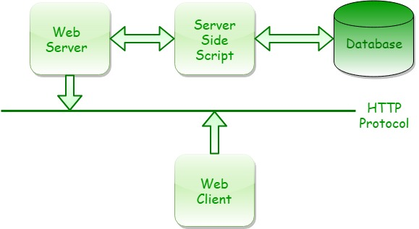
CGI programs can send many types of data or media, like documents, images, audio clips, etc. Most Web sites use CGI with fields for input and deals of dynamic content on the Web is done mainly using CGI. It is a method through which a web server can get/send the data from/to databases, documents, and other programs respectively, and then present that data to viewers through the web.
In the above figure, with the help of HTTP (Hyper Text Transfer Protocol) web browser which is running on client machine exchanges information with the web server. Since, CGI program and web server normally run on the same system on which the web server resides, depending on the request from the browser, web server either provides the document from its own document directory or executes a CGI program.

Slide 99
CGI Programming in Perl
Download “XAMPP” server.
After installation look for a folder naming “XAMPP” in C:
Now create your “.cgi” file in editor and give the path to perl (#!"c:\xampp\perl\bin\perl.exe“ in shebang line of your program)
Save your file with “.cgi” extension in C:\xampp\cgi-bin.
Create your html file in editor and save the file with “.html” extension in C:\xampp\htdocs.
Now open your web browser . Type local host.
If apache is running on system then it shows “It’s working!”.
If it’s not then open XAMPP server. This will start all services associated with xampp.
If your apache is in running state then again open browser and type localhost.

Slide 100
CGI File
#!"c:\xampp\perl\bin\perl.exe"
use strict;
use CGI ':standard';
my $name = param('name');
my $gender = param('gender');
my $profession = param('profession');
my @sports = param('sport');
my $list;
if (@sports)
{
$list = join ', ', @sports;
}
else
{
$list = 'Null';
}
print header,
start_html(-title=>$name), h1("Hello, $name"), h3 p('You have Submitted the following Data:'), h4 table(Tr(td('Name:'), h4 td($name)), h4 Tr(td('Gender:'),
h4 td($gender)), h4 Tr(td('Profession:'), h4 td($profession)), h4 Tr(td('Sports:'),
h4 td($list))),
end_html;

Slide 101
HTML FILE
<html> <head> <title>GfG Test Example Form</title> </head>
<body>
<h1>CGI-Example Form</h1> <h3><p>Information Required.</p></h3>
<form action="/cgi-bin/form.cgi" method="Post">
<table>
<tr> <td>Name:</td> <td><input type="text" name="name"><td> </tr>
<tr>
<td>Gender:</td>
<td><select name="gender" size="1">
<option>Female</option>
<option>Male</option>
<option>Transgender</option>
</select></td>
</tr>
<tr> <td>Profession:</td> <td><input type="text" name="profession"><td> </tr>
<tr>
<td>Sports:</td>
<td><input type="checkbox" name="sport“ value="Cricket">Cricket
<input type="checkbox" name="sport“ value="Hockey">Hockey
<input type="checkbox" name="sport“ value="TableTennis">TableTennis
<input type="checkbox" name="sport“ value="Football">Football</td>
</tr>
<tr>
<td colspan="2"><input type="submit"></td>
</tr>
</table>
</form> </body> </html>

Slide 102
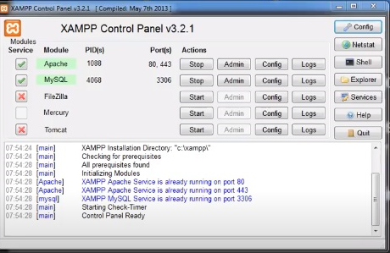

Slide 103
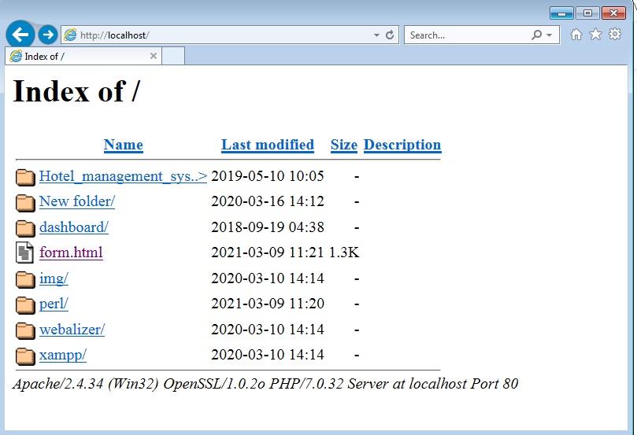

Slide 104
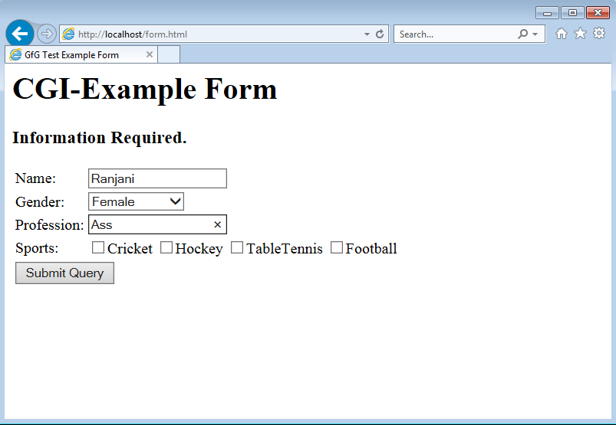

Slide 105
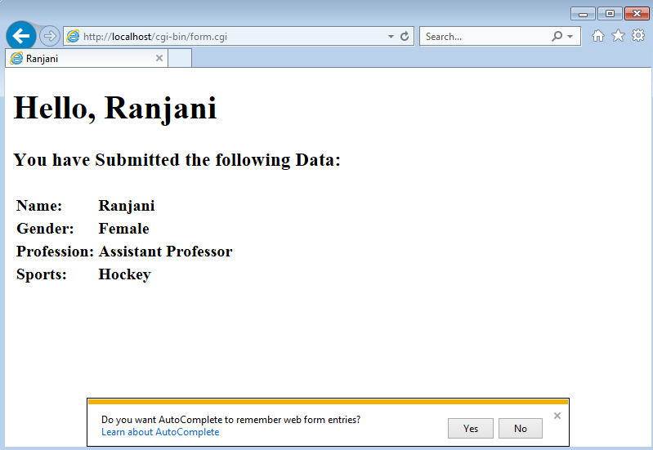

Slide 106
References
https://www.tutorialspoint.com/perl/
https://www.javatpoint.com/perl-tutorial
https://www.perltutorial.org/
http://www.tizag.com/perlT/
https://www.geeksforgeeks.org/introduction-to-perl/
https://www.codesdope.com/perl-file-io/
http://sandbox.mc.edu/~bennet/perl/leccode/

