Slide 1
Unit-1 HTML & CSS
by
Ranjani.B,
AP/CSE, EGSPEC

Slide 2
Contents
XHTML Evolution of HTML and XHTML- Standard XHTML Document Structure- Basic Text Markup- Images-Hypertext Links-Lists- Tables- Forms- Frames. Cascading Style Sheets Introduction to CSS – Levels of Style Sheets- Style Specification Formats- Selector Forms- Property Value Forms – Font Properties- List Properties – Color- Alignment of Text – Background Images- Span and Div Tags.

Slide 3
What are Markup Languages?
These markup languages are designed specifically to work for web development. Today, it is a foundation of the web and everything you see is the combination of markup text, CSS and front end scripts (interactivity) are based on mark up languages. It is what creates the final web presence. It sets the architecture of the website and gives it structure. These mark up languages structures data. Unlike other languages like Python or PHP or Ruby that guide the behavior of the data and the databases.

Slide 4
INTRODUCTION TO HTML
With HTML you can create your own Web site.
HTML stands for Hyper Text Markup Language.
HTML is derived from a language SGML (Standard Graphics Markup Language).
The future of HTML is XML (eXtended Markup Language).
HTML is not a programming language, it is a Markup Language.
A markup language is a set of markup tags.
HTML uses markup tags to describe web pages.
HTML is not case sensitive language.
HTML documents contain HTML tags and plain text.

Slide 5
HTML – Hyper Text Markup Language
HTML documents describe web pages (Static Web Page)
HTML tags are keywords surrounded by angle brackets like <html>
HTML tags normally come in pairs like <b> and </b>
The first tag in a pair is the start tag (opening tags),
the second tag is the end tag(closing tags)

Slide 6
Origins and Evolution of HTML
Hypertext Markup Language
Developed for the delivery of hypertext on the WWW
Built using SGML
ASCII “Markup Language”

Slide 7
Recent Versions
Tim Berners Lee – person who defined HTML in 1990 at CERN.
HTML 2.0 – 1994
launched World Wide Web Consortium(W3C) – standards for html
HTML 4.0 – 1997
Introduced many new features and deprecated many older features
HTML 4.01 - 1999 - A cleanup of 4.0
XHTML 1.0 – 2000
Just 4.01 defined using XML, instead of SGML
XHTML 1.1 – 2001
Modularized 1.0, and drops frames
XHTML 2.0 – development abandoned
HTML 5.0
Working Draft (not a W3C Recommendation yet)
HTML and XHTML syntax

Slide 8
What Is XHTML?
XHTML stands for EXtensible HyperText Markup Language
XHTML is almost identical to HTML
XHTML is stricter than HTML
XHTML is HTML defined as an XML application
XHTML is supported by all major browsers
XHTML was developed by combining the strengths of HTML and XML.
XHTML is HTML redesigned as XML.

Slide 9
Most Important Differences from HTML
Document Structure
XHTML DOCTYPE is mandatory
The xmlns attribute in <html> is mandatory
<html>, <head>, <title>, and <body> are mandatory
XHTML Elements
XHTML elements must be properly nested
XHTML elements must always be closed
XHTML elements must be in lowercase
XHTML documents must have one root element
XHTML Attributes
Attribute names must be in lower case
Attribute values must be quoted
Attribute minimization is forbidden

Slide 10
How to Convert from HTML to XHTML
Add an XHTML <!DOCTYPE> to the first line of every page
Add an xmlns attribute to the html element of every page
Change all element names to lowercase
Close all empty elements
Change all attribute names to lowercase
Quote all attribute values

Slide 11
<!DOCTYPE ....> Is Mandatory
An XHTML document must have an XHTML DOCTYPE declaration.
The <html>, <head>, <title>, and <body> elements must also be present, and the xmlns attribute in <html> must specify the xml namespace for the document.

Slide 12
EXAMPLE
This example shows an XHTML document with a minimum of required tags:
<!DOCTYPE html PUBLIC "-//W3C//DTD XHTML 1.0 Transitional//EN" "http://www.w3.org/TR/xhtml1/DTD/xhtml1-transitional.dtd"> <html xmlns="http://www.w3.org/1999/xhtml"> <head> <title>Title of document</title> </head>
<body> some content </body> </html>

Slide 13
XHTML Elements Must Be Properly Nested
This is wrong
<b><i>This text is bold and italic</b></i>
This is correct
<b><i>This text is bold and italic</i></b>
XHTML Elements Must Always Be Closed
This is wrong
<p>This is a paragraph
<p>This is another paragraph
This is correct
<p>This is a paragraph</p>
<p>This is another paragraph</p>

Slide 14
Empty Elements Must Also Be Closed
This is wrong
A break: <br>
A horizontal rule: <hr>
An image: <img src="happy.gif" alt="Happy face">
This is correct
A break: <br />
A horizontal rule: <hr />
An image: <img src="happy.gif" alt="Happy face" />
XHTML Elements Must Be In Lower Case
This is wrong
<BODY> <P>This is a paragraph</P> </BODY>
This is correct
<body> <p>This is a paragraph</p> </body>

Slide 15
XHTML Attribute Names Must Be In Lower Case
This is wrong
<table WIDTH="100%">
This is correct
<table width="100%">
Attribute Values Must Be Quoted
This is wrong
<table width=100%>
This is correct
<table width="100%">

Slide 16
Attribute Minimization Is Forbidden
Wrong:
<input type="checkbox" name="vehicle" value="car" checked />
Correct:
<input type="checkbox" name="vehicle" value="car" checked="checked" />
Wrong:
<input type="text" name="lastname" disabled />
Correct:
<input type="text" name="lastname" disabled="disabled" />

Slide 17
HTML vs XHTML
HTML and XHTML are both languages in which web pages are written. HTML is SGML-based while XHTML is XML-based. They are like two sides of the same coin. XHTML was derived from HTML to conform to XML standards. Hence XHTML is strict when compared to HTML and does not allow user to get away with lapses in coding and structure.

Slide 18
HTML vs XHTML
S.No | HTML | XHTML
1 | HTML or HyperText Markup Language is the main markup language for creating web pages and other information that can be displayed in a web browser. | XHTML (Extensible HyperText Markup Language) is a family of XML markup languages that mirror or extend versions of the widely used Hypertext Markup Language (HTML), the language in which web pages are written.
2 | .html, .htm | .xhtml, .xht, .xml, .html, .htm
3 | HTML is based on SGML. | XHTML is based on XML.
4 | HTML tags are case insensitive. | XHTML tags are case sensitive.

Slide 19
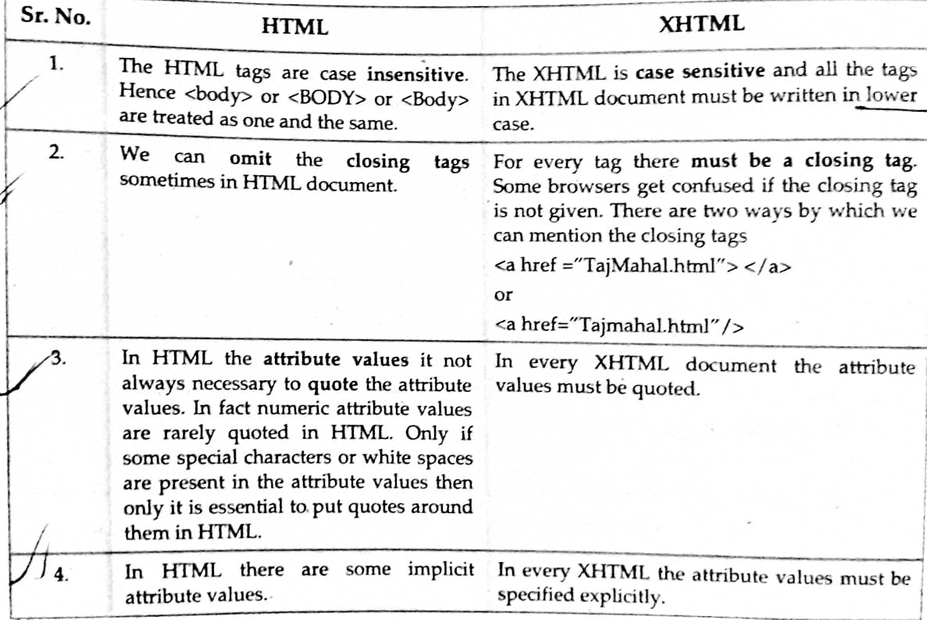

Slide 21
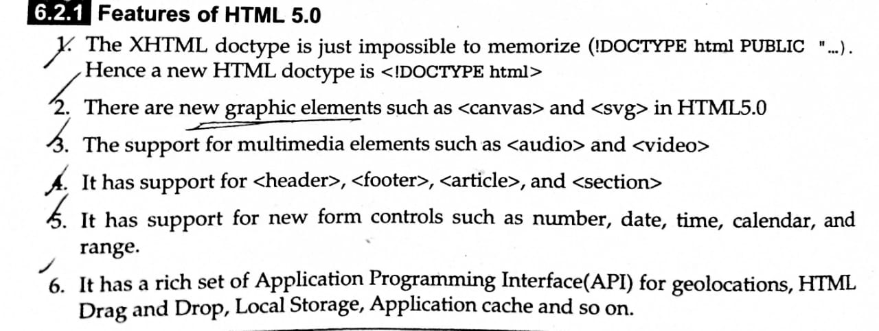

Slide 22
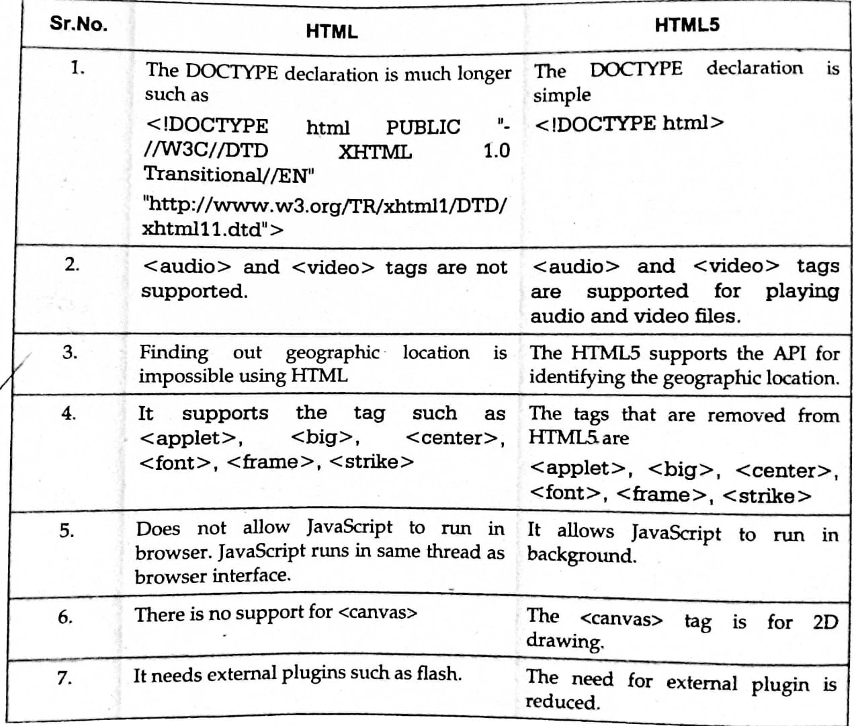

Slide 23
HTML Parts
An HTML document consists of 3 main parts
DOCTYPE declaration
<head> section
<body> section
<!DOCTYPE html>
<html>
<head>
<title> …. </title>
</head>
<body>
….
….
…
</body>
</html>

Slide 24
HTML Document Structure
An HTML document is composed of 3 parts:
1. a line containing HTML version information, e.g.:
<!DOCTYPE html PUBLIC "-//W3C//DTD HTML 4.01//EN“ "http://www.w3.org/TR/html4/strict.dtd">
Note: <!DOCTYPE html> for HTML5
2. a declarative header section
Delimited with the <head> tag
The <title>tag is used to give the document a title normally displayed in the browser’s window title bar
3. a body containing the document's actual content
Delimited with the <body> tag
After document type declaration, the remainder of an HTML document is contained by the html element

Slide 27
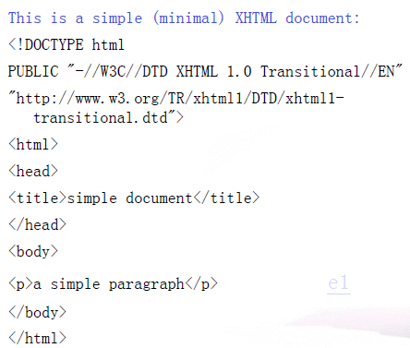

Slide 30
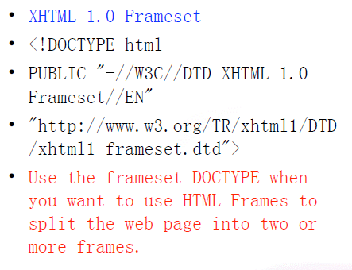

Slide 31
HTML Elements and Tags
A tag is always enclosed in angle bracket <>like <HTML>
HTML tags normally come in pairs like <HTML> and </HTML>
i.e. Start tag = <HTML> & End tag =</HTML>
Start and end tags are also called opening tags and closing tags.

Slide 32
HOW TO START
Write html code in notepad.
Save the file with (.Html)/(.Htm) extension.
View the page in any web browser viz. INTERNET EXPLORER, NETSCAPE NAVIGATOR etc.
The purpose of a web browser (like internet explorer or firefox) is to read html documents and display them as web pages.

Slide 33
HTML syntax
1.The DOCTYPE
2.Elements
3.Attributes
4.Comments

Slide 34
DOCTYPE
< !DOCTYPE html> - Required Header
Elements
<element> …………... </element>
Start tag Content End tag
Attributes
<element attribute=”value”>
Name Value

Slide 35
Comments
<!-- comment -->
Start Comment End
<HTML> - Describe HTML web page that is to be viewed by a web browser.
<HEAD> - This defines the header section of the page.
<TITLE> - This shows a caption in the title bar of the page.
<BODY> - This tag show contents of the web page will be displayed.

Slide 36
Code With HTML
<HTML>
<HEAD>
<TITLE> MY FIRST PAGE </TITLE>
</HEAD>
<BODY>
GLOBAL INFORMATION CHANNEL
</BODY>
</HTML>

Slide 37
Types of HTML Tags
There are two different types of tags:->
Container Element:->
Container Tags contains start tag & end tag i.e. <HTML>… </HTML>
Empty Element:->
Empty Tags contains start tag
i.e. <BR> - break

Slide 38
Text Formatting Tags
Heading Element:->
There are six heading elements (<H1>,<H2>,<H3>,<H4>, <H5>,<H6>).
All the six heading elements are container tag and requires a closing tag.
<h1> will print the largest heading
<h6> will print the smallest heading

Slide 39
Heading Tag Code
<html>
<head>
<title>heading</title>
</head>
<body>
<h1> GLOBAL INFO CHANNEL</h1>
<h2> GLOBAL INFO CHANNEL</h2>
<h3> GLOBAL INFO CHANNEL</h3>
<h4> GLOBAL INFO CHANNEL</h4>
<h5> GLOBAL INFO CHANNEL</h5>
<h6> GLOBAL INFO CHANNEL</h6>
</body>
</html>

Slide 40
Result of Heading Code

Slide 41
HTML Paragraph Tag
HTML documents are divided into paragraphs.
Paragraphs are defined with the <p> tag
i.e. <p>This is a paragraph</p>
<p>This is another paragraph</p>
<pre>This text is preformatted</pre>

Slide 42
Line Break & Horizontal Line Tag
If you want a line break or a new line without starting a new paragraph Use the <br> tag.
Defines a horizontal line use <hr>tag.
<br> <hr> element are empty HTML element
i.e. Global Information Channel <hr> Global Information <br> Channel

Slide 43
Text Formatting Tags
<b> Defines bold text
<big> Defines big text
<em> Defines emphasized text
<i> Defines italic text
<small> Defines small text
<strong> Defines strong text
<sub> Defines subscripted text
<sup> Defines superscripted text
<ins> Defines inserted text
<del> Defines deleted text
<tt> Defines teletype text
<u> Defines underline text
<strike> Defines strike text

Slide 44
Text Formatting Code
<html>
<head></head>
<body>
<b>This text is Bold</b>
<br><em>This text is Emphasized</em>
<br><i>This text is Italic</i>
<br><small>This text is Small</small>
<br>This is<sub> Subscript</sub> and
<sup>Superscript</sup>
<br><strong>This text is Strong</strong>
<br><big>This text is Big</big>
<br><u>This text is Underline</u>
<br><strike>This text is Strike</strike>
<br><tt>This text is Teletype</tt>
</body>
</html>

Slide 45
Result of Text Formatting Code

Slide 46
Font Tag
This element is used to format the size, typeface and color of the enclosed text.
The commonly used fonts for web pages are Arial, Comic Sans MS , Lucida Sans
Unicode, Arial Black, Courier New, Times, New Roman, Arial Narrow, Impact,Verdana.
The size attribute in font tag takes values from 1 to 7.

Slide 47
Font Tag Code
<html>
<head><title> fonts</title></head>
<body>
<br><font color=“green" size="7" face="Arial"> GLOBAL INFORMATION CHANNEL </font>
<br><font color=“green" size="6" face="Comic Sans MS "> GLOBAL INFORMATION CHANNEL </font>
<br><font color=“green" size="5" face="Lucida Sans Unicode"> GLOBAL INFORMATION CHANNEL </font>
<br><font color=“green" size="4" face="Courier New"> GLOBAL INFORMATION CHANNEL </font>
<br><font color=“green" size="3" face="Times New Roman"> GLOBAL INFORMATION CHANNEL </font>
<br><font color=“green" size="2" face="Arial Black"> GLOBAL INFORMATION CHANNEL </font>
<br><font color=“green" size="1" face="Impact"> GLOBAL INFORMATION CHANNEL </font>
</body>
</html>

Slide 48
Result of Font Code

Slide 49
Background & Text Color Tag
The attribute bgcolor is used for changing the back ground color of the page.
<body bgcolor=“Green” >
Text is use to change the color of the enclosed text.
<body text=“White”>

Slide 50
Text Alignment Tag
It is use to alignment of the text.
–Left alignment <align=“left”>
–Right alignment <align=“right”>
–Center alignment <align=“center”>

Slide 51
Hyperlink Tag
A hyperlink is a reference (an address) to a resource on the web.
Hyperlinks can point to any resource on the web: an HTML page, an image, a sound file, a movie, etc.
The HTML anchor element <a>, is used to define both hyperlinks and anchors.
<a href="url">Link text</a>
The href attribute defines the link address.
<a href="http://www.globalinfochannel/">Visit globalinfochannel!</a>

Slide 52
Result of Hyperlink Code

Slide 53
Image Tag
To display an image on a page, you need to use the src attribute.
src stands for "source". The value of the src attribute is the URL of the image you want to display on your page.
It is a empty tag.
<IMG SRC ="url">
<IMG SRC="picture.gif“>
<IMG SRC="picture.gif“ HEIGHT="30“ WIDTH="50">

Slide 54
Image attributes - <img> tag
<img> Defines an image
<Src> display an image on a page,
Src stands for "source"
<Alt> Define "alternate text" for an image
<Width> Defines the width of the image
<Height> Defines the height of the image
<Border> Defines border of the image
<Hspace> Horizontal space of the image
<Vspace> Vertical space of the image
<Align> Align an image within the text
<background>Add a background image to an HTML page

Slide 55
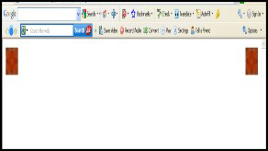
Code & Result of the Image
<html><body>
<p><img
src="file:///C:/WINDOWS/Zapotec.bmp"
align="left" width="48" height="48"> </p>
<p><img src
="file:///C:/WINDOWS/Zapotec.bmp"
align="right" width="48" height="48"></p>
</body></html>
<HTML>
<<body background="file:///C:/WINDOWS/Soap
%20Bubbles.bmp" text="white">
<br><br><br>
<h2> Background Image!</h2>
</BODY></HTML>

Slide 56
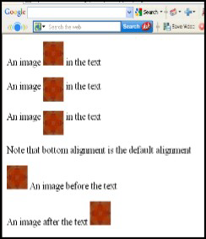
Code & Result of the Image
<html><body>
<p>An image
<img src="file:///C:/WINDOWS/Zapotec.bmp"
align="bottom" width="48" height="48"> in the text</p>
<p>An image
<img src ="file:///C:/WINDOWS/Zapotec.bmp"
align="middle" width="48" height="48"> in the text</p>
<p>An image
<img src ="file:///C:/WINDOWS/Zapotec.bmp"
align="top" width="48" height="48"> in the text</p>
<p>Note that bottom alignment is the default alignment</p>
<p><img src ="file:///C:/WINDOWS/Zapotec.bmp"
width="48" height="48">
An image before the text</p>
<p>An image after the text
<img src ="file:///C:/WINDOWS/Zapotec.bmp"
width="48" height="48"> </p>
</body></html>

Slide 57
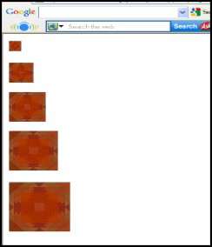
Code & Result of the Image
<html><body>
<p><img src="file:///C:/WINDOWS/Zapotec.bmp"
align="bottom" width="20" height="20"> </p>
<p><img src ="file:///C:/WINDOWS/Zapotec.bmp"
align="middle" width="40" height="40"></p>
<p><img src ="file:///C:/WINDOWS/Zapotec.bmp"
align="top" width="60" height="60"></p>
<p><img src ="file:///C:/WINDOWS/Zapotec.bmp"
width="80" height="80"> </p>
<p><img src ="file:///C:/WINDOWS/Zapotec.bmp"
width="100" height="100"> </p>
</body></html>

Slide 58
HTML Table Tag
<table> used to create table
<tr> table is divided into rows
<td> each row is divided into data cells
<th> Headings in a table
<Caption> caption to the table
<colgroup> Defines groups of table columns
<col> Defines the attribute values for one or more columns in a table
<thead> Defines a table head
<tbody> Defines a table body
<tfoot> Defines a table footer
<Cellspacing> amount of space between table cells.
<Cellpadding>space around the edges of each cell
<Colspan> No of column working with will span
<rowspan> No of rows working with will span attribute takes a number

Slide 59
<table> Tag
The <table> tag defines an HTML table.
An HTML table consists of the <table> element
<table> closing tag is </table>
An HTML table has two kinds of cells:
Header cells - contains header information (created with the <th> element)
Standard cells - contains data (created with the <td> element)

Slide 60
<th> Tag
The <th> tag defines a header cell in an HTML table.
Closing tag is </th>
The text in <th> elements are bold and centered by default.

Slide 61
<td> Tag
The <td> tag defines a standard cell in an HTML table.
The text in <td> elements are regular and left-aligned by default
Closing tag is </td>

Slide 62
<tr> Tag
The <tr> tag defines a row in an HTML table.
A <tr> element contains one or more <th> or <td> elements.
Closing tag is </tr>

Slide 63
<table> input

Slide 64
<table>output

Slide 65
Code & Result of the Table
<html>
<body>
<h3>Table without border</h3>
<table>
<tr> <td>MILK</td>
<td>TEA</td>
<td>COFFEE</td> </tr>
<tr> <td>400</td>
<td>500</td>
<td>600</td> </tr>
</table>
</body>
</html>

Slide 66
<caption> Tag
The <caption> tag defines a table caption.
The <caption> tag must be inserted immediately after the <table> tag.
we can specify only one caption per table.
By default, a table caption will be center aligned above a table.
Closing tag is </caption>

Slide 67
<caption> input

Slide 68
<caption> output

Slide 69
Table Code with Border & Header
<html><body>
<h4>Horizontal Header:</h4>
<table border="1">
<tr> <th>Name</th> <th>Loan No</th>
<th>Amount</th> </tr>
<tr> <td>Jones</td> <td>L-1</td>
<td>5000</td></tr> </table><br><br>
<h4>Vertical Header:</h4>
<table border="5">
<tr> <th>Name</th> <td>Jones</td> </tr>
<tr> <th>Loan No</th>
<td>L-1</td> </tr>
<tr> <th>Amount</th> <td>5000</td></tr>
</table>
</body></html>

Slide 70
<thead> Tag
The <thead> tag is used to group header content in an HTML table.
The <thead> element is used in conjunction with the <tbody> and <tfoot> elements to specify each part of a table (header, body, footer).
The <thead> tag must be used in the following context: As a child of a <table> element, after any <caption>, and <colgroup> elements, and before any <tbody>, <tfoot>, and <tr> elements.
The <thead> element must have one or more <tr> tags inside.

Slide 71
<tbody> Tag
The <tbody> tag is used to group the body content in an HTML table.
The <tbody> element is used in conjunction with the <thead> and <tfoot> elements to specify each part of a table (body, header, footer).
The <tbody> tag must be used in the following context: As a child of a <table> element, after any <caption>, <colgroup>, and <thead> elements.
The <tbody> element must have one or more <tr> tags inside.

Slide 72
<tfoot> Tag
The <tfoot> tag is used to group footer content in an HTML table.
The <tfoot> element is used in conjunction with the <thead> and <tbody> elements to specify each part of a table (footer, header, body).
The <tfoot> tag must be used in the following context: As a child of a <table> element, after any <caption>, <colgroup>, and <thead> elements and before any <tbody> and <tr> elements.
The <tfoot> element must have one or more <tr> tags inside.

Slide 73
Input

Slide 74
output

Slide 75
<col> Tag
The <col> tag specifies column properties for each column within a <colgroup> element.
The <col> tag is useful for applying styles to entire columns, instead of repeating the styles for each cell, for each row.

Slide 76
<colgroup> Tag
The <colgroup> tag specifies a group of one or more columns in a table for formatting.
The <colgroup> tag is useful for applying styles to entire columns, instead of repeating the styles for each cell, for each row.
The <colgroup> tag must be a child of a <table> element, after any <caption> elements and before any <thead>, <tbody>, <tfoot>, and <tr> elements.
To define different properties to a column within a <colgroup>, use the <col> tag within the <colgroup> tag.

Slide 77
input

Slide 78
output

Slide 79
Row span input

Slide 80
Rowspan output

Slide 81
Colspan input

Slide 82
Colspan output

Slide 83
Table Code with Colspan & Rowspan
<html><body>
<h4>Cell that spans two columns:</h4>
<table border="4">
<tr> <th>Name</th>
<th colspan="2">Loan No</th> </tr>
<tr> <td>Jones</td> <td>L-1</td>
<td>L-2</td> </tr> </table>
<h4>Cell that spans two rows:</h4>
<table border="8">
<tr> <th>Name</th>
<td>Jones</td></tr>
<tr> <th rowspan="2">Loan No</th>
<td>L-1</td></tr>
<tr> <td>L-2</td></tr> </table>
</body></html>

Slide 84
Table Code with Caption & ColSpacing
<html>
<body>
<table border="1">
<caption>My Caption</caption>
<tr>
<td>Milk</td>
<td>Tea</td>
</tr>
<tr>
<td></td>
<td>Coffee</td>
</tr>
</table>
</body>
</html>

Slide 85
Cellpadding, Image & Backcolor Code
<html><body>
<h3>Without cellpadding:</h3>
<table border="2" bgcolor="green">
<tr> <td>Jones</td>
<td>Smith</td></tr>
<tr> <td>Hayes</td>
<td>Jackson</td></tr></table>
<h4>With cellpadding:</h4>
<table border="8“ cellpadding="10" background="file:///C:/WINDOWS/ FeatherTexture.bmp">
<tr> <td>Jones</td>
<td>Smith</td></tr>
<tr> <td>Hayes</td>
<td>Jackson</td></tr></table>
</body></html>

Slide 86
HTML List Tag
Lists provide methods to show item or element sequences in document content.
There are three main types of lists:->
– Unordered lists:-unordered lists are bulleted
– Ordered lists:- Ordered lists are numbered
– Definition lists:- Used to create a definition list

Slide 87
List Tags
<LI> <LI> is an empty tag. it is used for representing the list items
<OL> Ordered list
<UL> Unordered list
<DL> Defines a definition list
<DT> Defines a term (an item) in a definition list
<DD> Defines a description of a term in a definition list

Slide 88
Unordered List
TYPE attribute to the <UL> tag to show different bullets like:-
–Disc
–Circle
–Square
<ul Type =“disc”>…..</ul>
The attribute TYPE can also be used with <LI> element.

Slide 89
Code & Result of the Unordered List
<html><body>
<h4>Disc bullets list:</h4>
<ul type="disc"> <li>Jones</li>
<li>Smith</li>
<li>Hayes</li>
<li>Jackson</li></ul>
<h4>Circle bullets list:</h4>
<ul type="circle"> <li>Jones</li>
<li>Simth</li>
<li>Hayes</li>
<li>Jackson</li></ul>
<h4>Square bullets list:</h4>
<ul type="square"> <li>Jones</li>
<li>Smith</li>
<li>Hayes</li>
<li>Jackson</li></ul>
</body></html>

Slide 90
Ordered List
The TYPE attribute has the following value like:-
–TYPE = "1" (Arabic numbers)
–TYPE = "a" (Lowercase alphanumeric)
–TYPE = "A" (Uppercase alphanumeric)
–TYPE = "i" (Lowercase Roman numbers)
–TYPE = "I" (Uppercase Roman numbers)
By default Arabic numbers are used

Slide 91
Code & Result of the Ordered List
<html><body>
<h4>Numbered list:</h4>
<ol> <li>Jones</li>
<li>Smith</li>
<li>Hayes</li>
<li>Jackson</li></ol>
<h4>Letters list:</h4>
<ol type="A"> <li>Jones</li>
<li>Smith</li>
<li>Hayes</li>
<li>Jackson</li></ol>
<h4>Roman numbers list:</h4>
<ol type="I"> <li>Jones</li>
<li>Smith</li>
<li>Hayes</li>
<li>Jackson</li></ol>
</body></html>

Slide 92
The start Attribute
You can use start attribute for <ol> tag to specify the starting point of numbering you need. Following are the possible options −
<ol type = "1" start = "4"> - Numerals starts with 4. <ol type = "I" start = "4"> - Numerals starts with IV. <ol type = "i" start = "4"> - Numerals starts with iv. <ol type = "a" start = "4"> - Letters starts with d. <ol type = "A" start = "4"> - Letters starts with D.

Slide 93
Example Following is an example where we used <ol type = "i" start = "4" >
<!DOCTYPE html>
<html>
<head>
<title>HTML Ordered List</title>
</head>
<body>
<ol type = "i" start = "4">
<li>Beetroot</li>
<li>Ginger</li>
<li>Potato</li>
<li>Radish</li>
</ol>
</body>
</html>

Slide 94
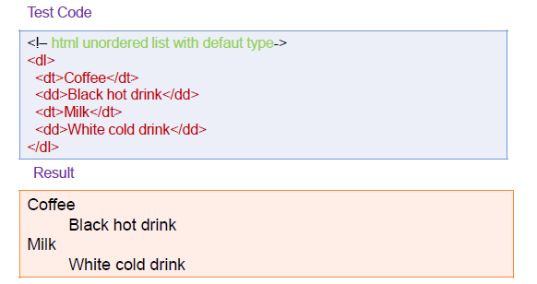
DEFINTION LIST
Used for definitions. Like google define (ex: define: php).
Starts with <dl> tag. Each term starts with <dt> tag.
Description of term starts with <dd> tag.

Slide 95
HTML FRAMES
Frame is a container window that can display a web page; Many web pages can display; Break the page into different sections
– Title
– Navigational
– Contents
– Footer

Slide 96
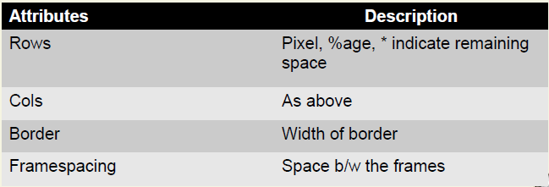
FRAME Tags
<frameset>
Define the style and no. of frames
Nested <frameset> also allowed

Slide 97
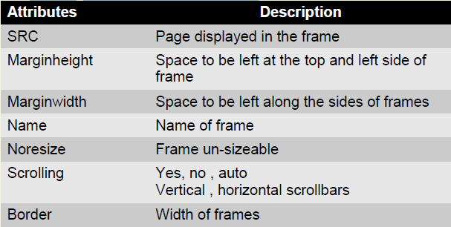
Tags contd…
<frame>
Nested in frameset tag

Slide 98
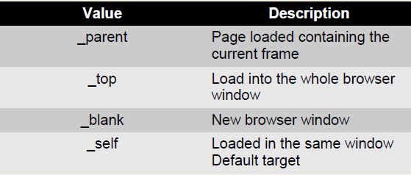
Tags contd….
Target Frame

Slide 99
Creating Frames - <frameset> Element
The <frameset> tag replaces the <body> element in frameset documents.
The <frameset> tag defines how to divide the window into frames.
Each frameset defines a set of rows or columns. If you define frames by using rows then horizontal frames are created. If you define frames by using columns then vertical frames are created.
The values of the rows/columns indicate the amount of screen area each row/column will occupy.
Each frame is indicated by <frame> tag and it defines what HTML document to put into the frame.

Slide 100
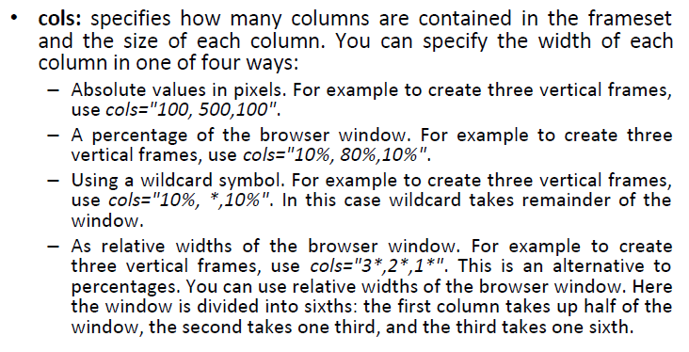
The <frameset> Element Attributes

Slide 101
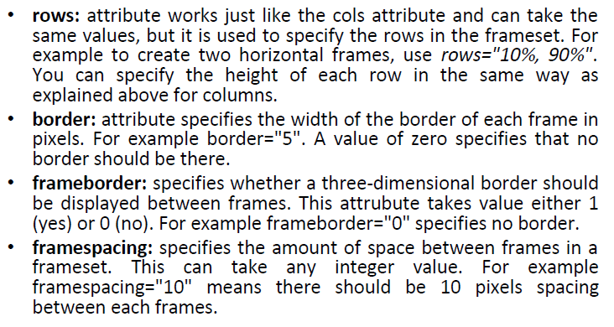
The <frameset> Element Attributes

Slide 102
Loading Content - <frame> Element
The <frame> element indicates what goes in each frame of the frameset.
The <frame> element is always an empty element, and therefore should not have any content, although each <frame> element should always carry one attribute, src, to indicate the page that should represent that frame.

Slide 103
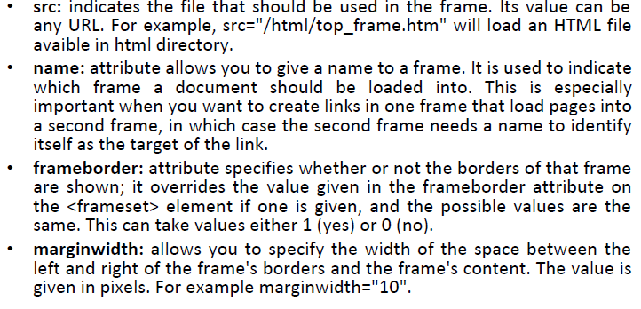
The <frame> Element Attributes

Slide 104
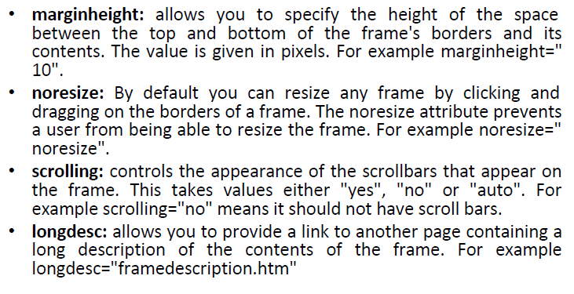
The <frame> Element Attributes

Slide 105
Browser Support - <noframes> Element
If a user is using any old browser or any browser which does not support frames then <noframes> element should be displayed to the user.
In XHTML you must place a <body> element inside the <noframes> element because the <frameset> element is supposed to replace the <body> element, but if a browser does not understand the <frameset> element it should understand what is inside the <body> element contained in the <noframes> element.
You can put some nice message for your user having old browsers. For example Sorry!! your browser does not support frames.

Slide 106
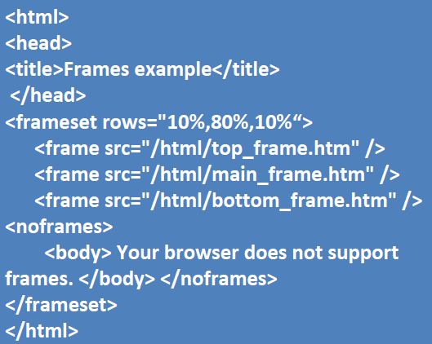
Example-1

Slide 107
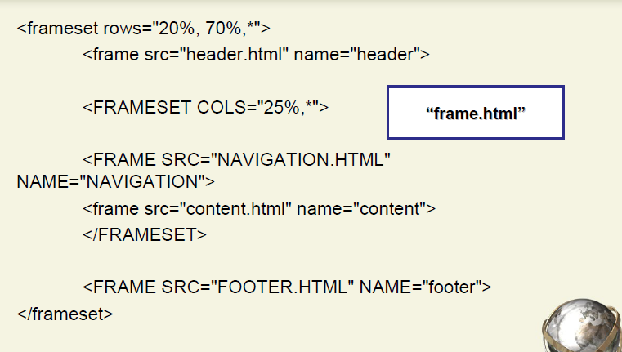
Example-2

Slide 108
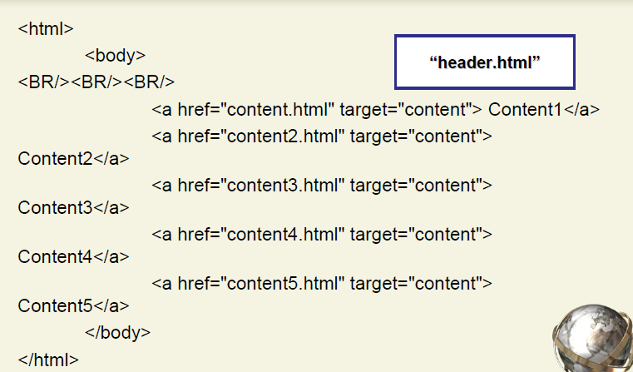

Slide 109
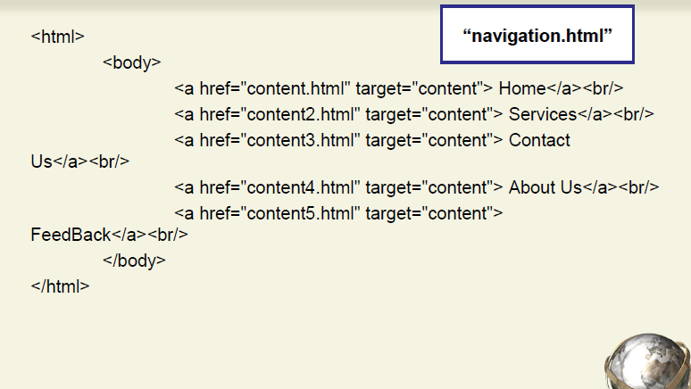

Slide 110
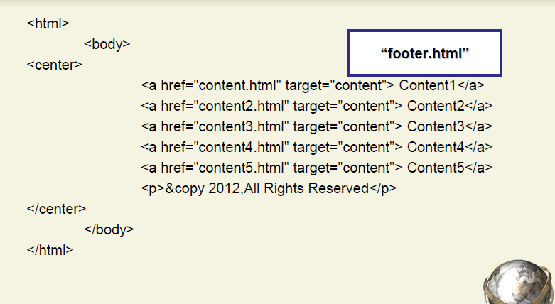

Slide 111
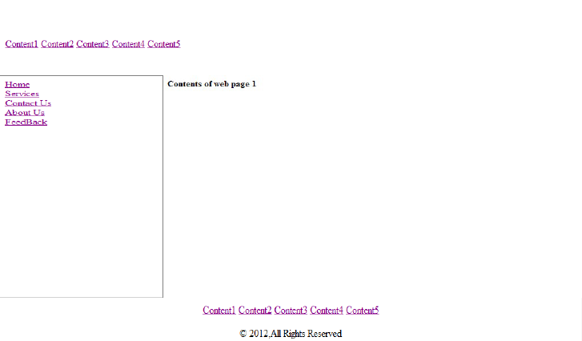
Output

Slide 112
HTML Form
A form is an area that can contain form elements.
Form elements are elements that allow the user to enter information in a form like text fields, text area fields, drop-down menus, radio buttons and checkboxes etc
A form is defined with the <form> tag.
The syntax:-
<form>
.
input elements
.
</form>

Slide 113
Form Tags
<form> defines a form for user input
<input>used to create an input field
<text>Creates a single line text entry field
<textarea>Defines a text-area (a multi-line text input control)
<password>Creates a single line text entry field. And the characters entered are shown as asterisks (*)
<label>Defines a label to a control
<option>Creates a Radio Button.
<select>Defines a selectable list (a drop-down box)
<button>Defines a push button
<value>attribute of the option element.
<checkbox>select or unselect a checkbox
<dropdown box>A drop-down box is a selectable list

Slide 114
Code of the HTML Form
<html><body><form>
<h1>Create a Internet Mail Account</h1>
<p>First Name <input type="text" name="T1" size="30"></p>
<p>Last Name <input type="text" name="T2" size="30"></p>
<p>Desired Login Name <input type="text" name="T3" size="20"> @mail.com</p>
<p>Password <input type="password" name="T4" size="20"></p>
<input type="radio" checked="checked" name="sex" value="male" /> Male</br>
<input type="radio" name="sex" value="female" /> Female
<p>Birthday <input type="text" name="T6" size="05">
<select size="1" name="D2">
<option>-Select One-</option>
<option>January</option>
<option>February</option>
<option>March</option> </select>
<input type="text" name="T7" size="10"></p>
TypeYourself<textarea rows="4" name="S1" cols="20"></textarea>
<br><input type="submit" value="Accept" name="B1"> <input
type="reset“ value="Cancel" name="B2"></br> </form></body></html>

Slide 115
Result of the Form Code

Slide 116
CSS-What is CSS?
Style.css
CSS stands for Cascading Style Sheet. Styles define how to display HTML elements
Typical CSS file is a text file with an extention.css and contains a series of commands or rules.
These rules tell the HTML how to display.
* To create a style sheet, create a file using Notepad (PC) or Text Edit (Mac), save it as a .css document and start writing the CSS code (see right).
/* Styles for sitename.com*/
body {
font-family:Arial;
background: #000;
}
#container {
text-align:left;
width:1020px;
}
#header {
height:232px;
}
#footer {
width: 100%;
padding: 0 10px;
margin-bottom: 10px;
}
And so on….

Slide 117
CSS Versions
CSS has various levels and profiles. Each level of CSS builds upon the last, typically adding new features and typically denoted as CSS1, CSS2, and CSS3.
The first CSS specification to become an official W3C Recommendation is CSS level 1, published in December 1996.
CSS level 2 was developed by the W3C and published as a Recommendation in May 1998. A superset of CSS1, CSS2 includes a number of new capabilities like absolute, relative, and fixed positioning of elements and z-index, the concept of media types etc.
CSS 3
CSS lev el 3 is currently under development. The W3C maintains a CSS3 progress report.

Slide 118
Why to Learn CSS?
Cascading Style Sheets, fondly referred to as CSS, is a simple design language intended to simplify the process of making web pages presentable.
CSS is a MUST for students and working professionals to become a great Software Engineer specially when they are working in Web Development Domain. I will list down some of the key advantages of learning CSS:
Create Stunning Web site - CSS handles the look and feel part of a web page. Using CSS, you can control the color of the text, the style of fonts, the spacing between paragraphs, how columns are sized and laid out, what background images or colors are used, layout designs, variations in display for different devices and screen sizes as well as a variety of other effects.
Become a web designer - If you want to start a carrer as a professional web designer, HTML and CSS designing is a must skill.
Control web - CSS is easy to learn and understand but it provides powerful control over the presentation of an HTML document. Most commonly, CSS is combined with the markup languages HTML or XHTML.
Learn other languages - Once you understands the basic of HTML and CSS then other related technologies like javascript, php, or angular are become easier to understand.

Slide 119
Applications of CSS
CSS saves time - You can write CSS once and then reuse same sheet in multiple HTML pages. You can define a style for each HTML element and apply it to as many Web pages as you want.
Pages load faster - If you are using CSS, you do not need to write HTML tag attributes every time. Just write one CSS rule of a tag and apply it to all the occurrences of that tag. So less code means faster download times.
Easy maintenance - To make a global change, simply change the style, and all elements in all the web pages will be updated automatically.
Superior styles to HTML - CSS has a much wider array of attributes than HTML, so you can give a far better look to your HTML page in comparison to HTML attributes.
Multiple Device Compatibility - Style sheets allow content to be optimized for more than one type of device. By using the same HTML document, different versions of a website can be presented for handheld devices such as PDAs and cell phones or for printing.
Global web standards - Now HTML attributes are being deprecated and it is being recommended to use CSS. So its a good idea to start using CSS in all the HTML pages to make them compatible to future browsers.

Slide 120
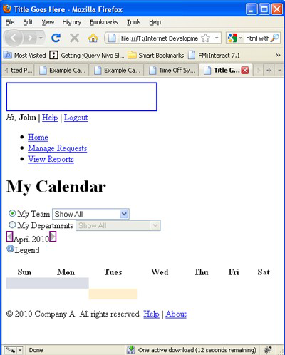
HTML Without CSS
“HTML without CSS is like a piece of candy without a pretty wrapper.”
Without CSS, HTML elements typically flow from top to bottom of the page and position themselves to the left by default.
With CSS help, we can create containers or DIVs to better organize content and make a Web page visually appealing.

Slide 121
HTML & CSS
HTML and CSS work together to produce beautiful and functional Web sites
HTML = structure
CSS = style

Slide 122
Hello World using CSS.
<!DOCTYPE html>
<html>
<head>
<title>This is document title</title>
<style>
h1 {
color: #36CFFF;
}
</style>
</head>
<body>
<h1>Hello World!</h1>
</body>
</html>

Slide 123
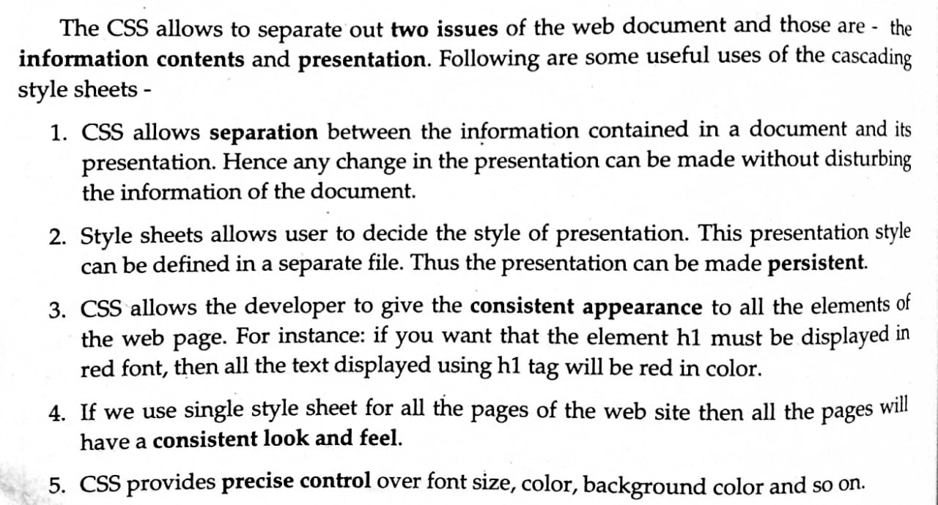
Features of CSS

Slide 124
CSS - Syntax
A CSS comprises of style rules that are interpreted by the browser and then applied to the corresponding elements in your document. A style rule is made of three parts −
Selector − A selector is an HTML tag at which a style will be applied. This could be any tag like <h1> or <table> etc.
Property − A property is a type of attribute of HTML tag. Put simply, all the HTML attributes are converted into CSS properties. They could be color, border etc.
Value − Values are assigned to properties. For example, color property can have value either red or #F1F1F1 etc.

Slide 125
Understanding Style Rules
A Style Rule is composed of two parts: a selector string and a declaration block.
CSS Style Rule Syntax as follow:
selector { property: value;}
The Selector indicates the element to which the rule is applied.
The Declaration determines the property values of a selector.

Slide 126
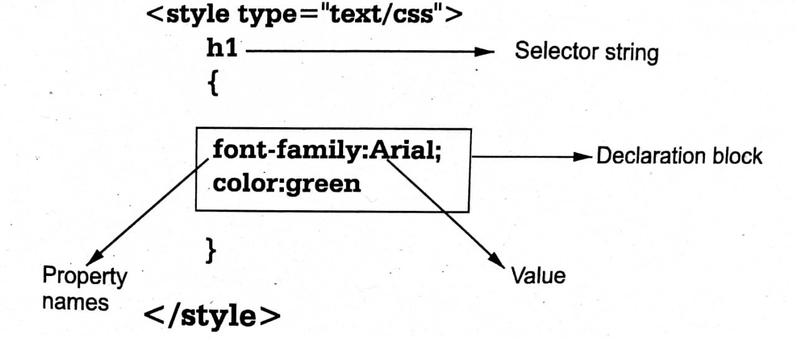

Slide 127
CSS declarations always ends with a semicolon, and declaration groups are surrounded by curly brackets:
p {color:red;text-align:center;}
To make the CSS more readable, you can put one declaration on each line, like this:
Example
p{
color:red;
text-align:center;
}
CSS Comments
A CSS comment begins with "/*", and ends with "*/", like this:
/*This is a comment*/
p{
text-align:center;
/*This is another comment*/
color:black;
font-family:arial;
}

Slide 128
CSS - Measurement Units
Unit | Description | Example
% | Defines a measurement as a percentage relative to another value, typically an enclosing element. | p {font-size: 16pt; line-height: 125%;}
cm | Defines a measurement in centimeters. | div {margin-bottom: 2cm;}
em | A relative measurement for the height of a font in em spaces. Because an em unit is equivalent to the size of a given font, if you assign a font to 12pt, each "em" unit would be 12pt; thus, 2em would be 24pt. | p {letter-spacing: 7em;}
ex | This value defines a measurement relative to a font's x-height. The x-height is determined by the height of the font's lowercase letter x. | p {font-size: 24pt; line-height: 3ex;}
in | Defines a measurement in inches. | p {word-spacing: .15in;}
mm | Defines a measurement in millimeters. | p {word-spacing: 15mm;}
pc | Defines a measurement in picas. A pica is equivalent to 12 points; thus, there are 6 picas per inch. | p {font-size: 20pc;}
pt | Defines a measurement in points. A point is defined as 1/72nd of an inch. | body {font-size: 18pt;}
px | Defines a measurement in screen pixels. | p {padding: 25px;}

Slide 129
CSS Selectors
There are 5 varieties of CSS Selectors available for us. We will be looking at the following important CSS Selectors:
CSS Universal Selector.
CSS Element Selector.
CSS Id Selector.
CSS Class Selector.
CSS Attribute Selector.

Slide 130
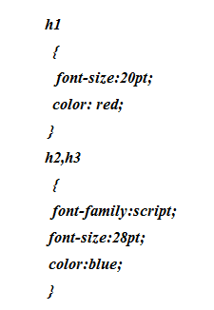
Simple Selector
Simple selector form is a single element to which the property and value is applied.

Slide 131
Universal Selector
In an HTML page, the content depends on HTML tags. A pair of tags defines a specific webpage element. The CSS universal selector selects all the elements on a webpage.
* { color: blue; font-size: 21px; }
These two lines of code surrounded by the curly braces will affect all the elements present on the HTML page. We declare a universal selector with the help of an asterisk at the beginning of the curly brace. Universal Selector can be used along with the other selectors in combination.

Slide 132
CSS Element Selector
CSS Element Selector is also known as a Type selector. Element Selector in CSS tries to match one or more HTML elements having the same name. Therefore, a selector of <ul> matches all the <ul> elements i.e. all the unordered lists in that HTML page.
ul
{ list-style: none;
border: solid 1px #ccc;
}
<ul>
<li>Fish</li>
<li>Apples</li>
<li>Cheese</li>
</ul>
<div class="example">
<p>Example paragraph text.</p>
</div>
<ul>
<li>Water</li>
<li>Juice</li>
<li>Maple Syrup</li>
</ul>
There are three main elements making up this part of the page:
Two <ul> elements and a <div>.
The CSS will apply only to the two <ul> elements,
and not to the <div>.
Were we to change the element type selector to use <div> instead of <ul>, then the styles would apply to the <div> and not to the two <ul> elements.
Also note that the styles will not apply to the elements inside the <ul> or <div> elements.

Slide 133
ID Selector
An ID selector is declared using a hash, or pound symbol (#) preceding a string of characters. The string of characters is defined by the developer. This selector matches any HTML element that has an ID attribute with the same value as that of the selector, but minus the hash symbol.
#container {
width: 960px;
margin: 0 auto;
}
This CSS uses an ID selector to match an HTML element such as:
<div id="container"></div>
In this case, the fact that this is a <div> element doesn’t matter— it could be any kind of HTML element. As long as it has an ID attribute with a value of container, the styles will apply. An ID element on a web page should be unique. That is, there should only be a single element on any given page with an ID of container. This makes the ID selector quite inflexible, because the styles used in the ID selector rule set can be used only once per page. If there happens to be more than one element on the page with the same ID, the styles will still apply, but the HTML on such a page would be invalid from a technical standpoint, so you’ll want to avoid doing this.

Slide 134
CSS Class Selector
The CSS Class selector is one of the most helpful selectors of all the selectors. It is declared by using a dot followed by the name of the class. This class name is defined by the coder, as is the case with the ID selector. The class selector searches for every element having an attribute value with the same name as the class name, without the dot.
.square { margin: 20px; width: 20px; }
This CSS code can be used to match the element having the class ‘square,
like in the following sentence.
<div class="square"></div>
This style also applies to all the other HTML elements having an attribute value for the class as ‘square’.
An element having the same class attribute value helps us in reusing the styles and avoids unnecessary repetition.
Additionally, the Class Selector is beneficial because it permits us to add several classes to a particular element.
We can add more than one class to the attribute by separating each class with space.
Example:
<div class=”square bold shape”></div>
Here square, bold and shape are three different types of classes.

Slide 135
CSS Attribute Selector
The CSS Attribute selector styles content according to the attribute and the attribute value mentioned in the square brackets. No spaces can be present ahead of the opening square bracket.
input[type="text"] { background-color: #fff; width: 100px; }
This CSS code would be a match for the following HTML element.
<input type="text">
Similarly, if the value of the attribute ‘type’ changes, the Attribute selector would not match it.
For example, the selector would not match the attribute if the value of ‘type’ changed from ‘text’ to ‘submit’.
If the attribute selector is declared with only the attribute, and no attribute value, then it will match to all the
HTML elements with the attribute ‘type’, regardless of whether the value is ‘text’ or ‘submit’.

Slide 136
Example:
input[type] { background-color: #fff; width: 100px; }
We can also make use of attribute selectors with no specification of a value outside the square brackets.
This will help us to target the attribute only, regardless of the element. In our example, it will target based on the attribute ‘type’, regardless of the element ‘input’.
CSS Selectors help us to simplify our code and enable us to utilize and reuse the same CSS code for various HTML elements.
They help us in styling specific segments and portions of our webpage.
They provide us with the option of uniformly styling similar elements in our web page.
CSS selectors are thus, an important part of the learning curve of CSS.

Slide 137
The advantage to this method is that the <input type = "submit" /> element is unaffected, and the color applied only to the desired text fields.
There are following rules applied to attribute selector.
p[lang] − Selects all paragraph elements with a lang attribute.
p[lang="fr"] − Selects all paragraph elements whose lang attribute has a value of exactly "fr".
p[lang~="fr"] − Selects all paragraph elements whose lang attribute contains the word "fr".
p[lang|="en"] − Selects all paragraph elements whose lang attribute contains values that are exactly "en", or begin with "en-".

Slide 138
Multiple Style Rules
You may need to define multiple style rules for a single element. You can define these rules to combine multiple properties and corresponding values into a single block as defined in the following example −
H1 {
color: #36C;
font-weight: normal; letter-spacing: .4em;
margin-bottom: 1em;
text-transform: lowercase;
}
Here all the property and value pairs are separated by a semicolon (;). You can keep them in a single line or multiple lines. For better readability, we keep them in separate lines.

Slide 139
Pseudo-class
Using Pseudo classes we can give special effects on the selectors. Most commonly used pseudo- classes are
Focus->select links that are the current focus of the keyboard
Hover ->When the mouse cursor rolls over a link, that link is in it's hover state and this will select it.
hyperlink
Active->Selects the link while it is being activated
Visited->Selects links that have already been visited by the current browser.
a:hover { color: red; }

Slide 140
Grouping Selectors
You can apply a style to many selectors if you like. Just separate the selectors with a comma, as given in the following example −
h1, h2, h3 {
color: #36C;
font-weight: normal;
letter-spacing: .4em;
margin-bottom: 1em;
text-transform: lowercase;
}
This define style rule will be applicable to h1, h2 and h3 element as well. The order of the list is irrelevant. All the elements in the selector will have the corresponding declarations applied to them.
You can combine the various id selectors together as shown below −

Slide 141
Different types of Stylesheets
The information contents of any web document can be represented with the help of cascading style sheets. We can define the stylesheets in 3 ways:
Internal - Placed right on the page whose interface it will affect.
External - Placed in a separate file.
Inline - Placed inside a tag it will affect.

Slide 142
Inline Stylesheet
Use inline stylesheets when you want to apply a style to a single occurence of an element.
Inline stylesheets are declared within individual tags and affect those tags only (defined inside HTML element).
An inline stylesheet has the highest priority.
Inline stylesheets are declared with the style attribute in the corresponding tag.
In-line CSS style consists set of rules in 4 part:
Selector (Element)
Style (Attribute)
Property and
Value

Slide 143
How to write In-line CSS Style
Selector is normally HTML element that element you want to assign CSS style. And style is attribute to assign CSS property and set suitable value.

Slide 144
Example

Slide 145
Internal Stylesheet
Internal CSS Style includes within web page using <style type="text/css">.....</style> element and between this element CSS style properties are listed. Internal CSS style normally written within <head>.....</head> element of the web page.
An internal stylesheet has the second highest priority.
Internal CSS style consists set of rules in 3 part:
Selector (element, class, id)
Property and
Value

Slide 146
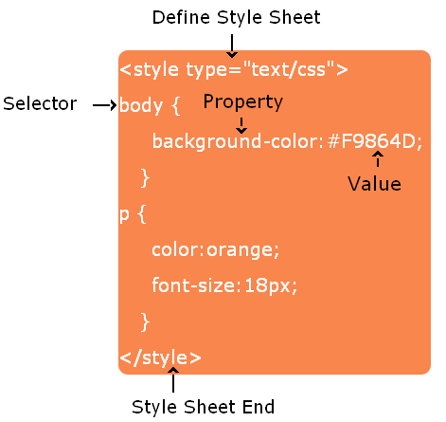
How to write Internal CSS Style
Selector is normally HTML element that element you want to assign CSS style. All elements within web page that elements assign CSS properties and set suitable values.

Slide 147
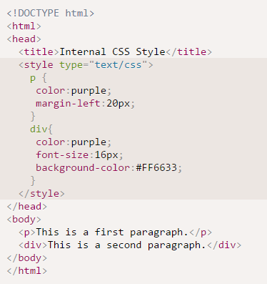
Example

Slide 148
External Stylesheet
Use an external stylesheet when you want to apply one style to many pages. If you make one change in an external stylesheet, the change is universal on all the pages where the stylesheet is used.
An external stylesheet is declared in an external file with a .css extension. It is called by pages whose interface it will affect. External stylesheets are called using the <link> tag which should be placed in the head section of an HTML document. This tag takes three attributes.
An external stylesheet has the third highest priority.
External style sheet consists set of rules in 4 part:
1. External Source link
2. Selector (element, class, id)
3. Property and
4. Value

Slide 149
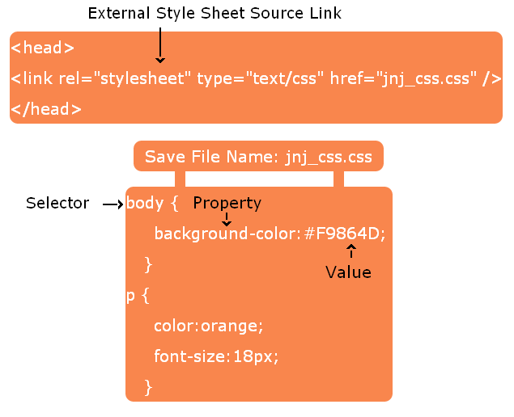
How to write External Stylesheet
External stylesheet linked to a web page. Selector is normally HTML element (or class, id) to assign CSS properties and set suitable values.

Slide 150
<link> Tag
<link> tells browser some file must be linked to the page.
When we want to link the external style sheet then we have to use <link> tag which is to be written in the head section.
Attributes of the <link> tag:
rel = stylesheet tells the browser that this linked thing is a stylesheet.
type = "text/css“ tells browser that what it is reading is text which is affected by the CSS.
href = “ ” denotes the name and location (pathname) of the external stylesheet to be used.

Slide 151
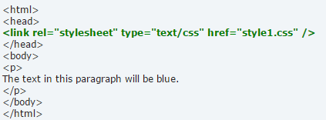
Example
NOTE: The <style> tag is NOT used in an external stylesheet, and neither are HTML comments.

Slide 152
@import Style Sheet
@import CSS Style is another way to loading a CSS file.
@import CSS Style define within
<style type="text/css">.....</style>
element in your
<head>.....</head> of your web page.
@import CSS style consists set of rules in 3 part:
@import (keyword)
url()
CSS file path
How to write @import CSS Style
@import url('style.css');

Slide 153
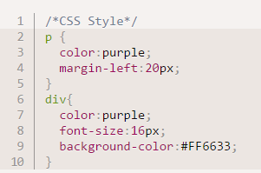
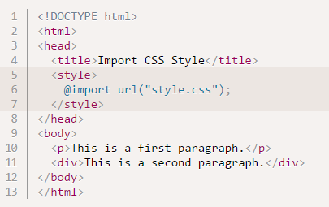
Example

Slide 154
CSS Text Properties
Using this properties you can change the text formatting style. Following are some CSS text properties listed:
CSS Color
CSS text-direction
CSS text-align
CSS text-indent
CSS text-decoration
CSS text-transformation
CSS letter-spacing
CSS word-spacing
CSS white-space
CSS text-shadow

Slide 155
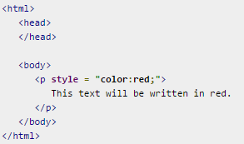
CSS Color
CSS color property use to set the Text color. The color value can be specified following three types:
Color Name: Orange
Color Hexadecimal Code: #FFA500
Color RGB: rgb(255, 165, 0)
Example

Slide 156
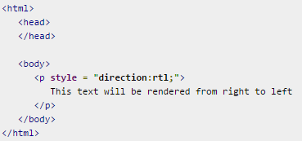
CSS Text-Direction
CSS Text-Direction property is used to set the text direction. Possible values are ltr or rtl.

Slide 157
CSS Text-Align
CSS text-align property use to set the horizontal alignment of text. Text-align possible value center, left, right, or justify. When you set text-align property value justify than the effect is both width (left or right) equal like newspaper or books type.
<!DOCTYPE html>
<html>
<head>
<title>CSS Text Align</title>
</head>
<body>
<p style="text-align: right;">CSS text align right</p>
<p style="text-align: center;">CSS text align center</p>
<p style="text-align: left;">CSS text align left</p>
<p style="text-align: justify;">Hello, this is example of CSS text-align justify type. Both side left and right are equal. Its like newspaper or book type. Hello, this is example of CSS text-align justify type. Both side left and right are equal. Its like newspaper or book type. Hello, this is example of CSS text-align justify type. Both side left and right are equal. Its like newspaper or book type.</p>
</body>
</html>

Slide 159
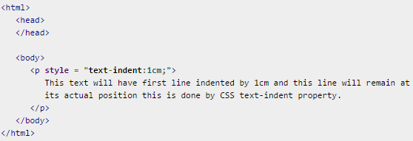
CSS Text-Indent
CSS text-indent property is used to set the paragraph first line left side leave the blank space. Possible values are % or a number specifying indent space.

Slide 160
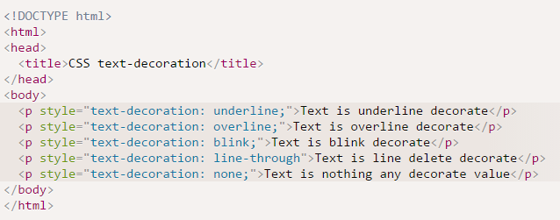
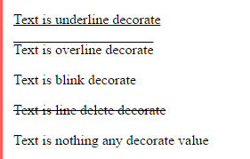
CSS Text-Decoration
CSS text-decoration property use to decorate the text. Possible values are none, underline, overline, blink, line-through etc.

Slide 161
CSS Text-Transformation
CSS text-transformation property use to text transform. CSS text-transformation possible value none, capitalize, lowercase and uppercase in a text. CSS text-transformation property value capitalize, it means first letter capital for all word.
<!DOCTYPE html>
<html>
<head>
<title>CSS text-transform</title>
</head>
<body>
<p style="text-transform: capitalize">This text transform to capital.</p>
<p style="text-transform: lowercase">This text transform to lowercase.</p>
<p style="text-transform: uppercase">This text transform to uppercase.</p>
</body>
</html>

Slide 162
CSS Letter-Spacing
CSS letter-spacing property set blank space between each letters. Possible values are normal or a number specifying space..
<!DOCTYPE html>
<html>
<head>
<title>CSS letter-spacing</title>
</head>
<body>
<p style="letter-spacing: 5px;">This text is having space between letters.</p>
</body>
</html>

Slide 163
CSS Word-Spacing
CSS word-spacing property set blank space between each words. Possible values are normal or a number specifying space.
<!DOCTYPE html> <html>
<head>
<title>CSS word-spacing</title>
</head>
<body>
<p style="word-spacing: 25px;">This text is having space between words.</p>
</body>
</html>

Slide 164
CSS White-Space
CSS white-space property use to set a predefine task. CSS white-space possible value is 'normal', 'pre‘, ‘nowrap’.
<!DOCTYPE html>
<html>
<head>
<title>CSS white-space</title>
</head>
<body>
<p style="white-space: pre;">
This text has a line break and the white-space pre setting
tells the browser to honor it just like the HTML pre tag.
</p>
</body>
</html>

Slide 165
CSS Text-Shadow
CSS text-shadow property is use to decorate text and apply shadow effect style. This may not be supported by all the browsers.
<!DOCTYPE html>
<html>
<head>
<title>CSS text-shadow</title>
</head>
<body>
<p style="text-shadow: 4px 4px 8px orange;">
This text is represent text shadow effect.</p>
</body>
</html>

Slide 166
CSS Font Properties
Using CSS font properties you can change the font formatting style. Here are some CSS font properties listed.
Font-Families
Font-Style
Font-Variant
Font-Weight
Font-Size
Font-Shorthands

Slide 167
CSS Font-Family
CSS font-family property to define font face name with one or more font. Single Quote (' ') is first priority to apply first. If that font not available then left to right optional apply (eg. Courier).
<!DOCTYPE html>
<html>
<head>
<title>CSS Font Family</title>
</head>
<body>
<p style="font-family: 'Courier New', Courier, monospace;">
This text is represent font family property.</p>
</body>
</html>

Slide 168
Text Property-Font-Families
The font-family property specifies the font for an element.
There are two types of font family names:
family-name - The name of a font-family, like "times", "courier", "arial", etc.
generic-family - The name of a generic-family, like "serif", "sans-serif", "cursive", "fantasy", "monospace".
Syntax
font-family: family-name|generic-family|initial|inherit;
Value | Description
family-name generic-family | A prioritized list of font family names and/or generic family names
initial | Sets this property to its default value.
inherit | Inherits this property from its parent element.

Slide 169
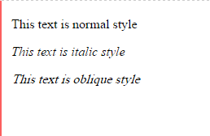
CSS Font-Style
CSS font-style property use to set font style like normal, italic, oblique.
<!DOCTYPE html>
<html>
<head>
<title>CSS Font Style</title>
</head>
<body>
<p style="font-style: normal;">This text is normal style</p>
<p style="font-style: italic;">This text is italic style</p>
<p style="font-style: oblique;">This text is oblique style</p>
</body>
</html>

Slide 170
CSS Font-Variant
CSS font-variant property set word first capital letter can be display in variant style. Possible values are normal and small-caps.
<!DOCTYPE html>
<html>
<head>
<title>CSS Font Variant</title>
</head>
<body>
<p style="font-variant: small-caps">This text is represent font variant.</p>
</body>
</html>

Slide 171
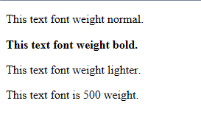
CSS Font-Weight
CSS font-weight property use to set font weight like bold, bolder, lighter. The font-weight property provides the functionality to specify how bold a font is. Possible values could be normal, bold, bolder, lighter, 100, 200, 300, 400, 500, 600, 700, 800, 900.
<!DOCTYPE html>
<html>
<head>
<title>CSS Font Weight</title>
</head>
<body>
<p style="font-weight: normal;">This text font weight normal.</p>
<p style="font-weight: bold;">This text font weight bold.</p>
<p style="font-weight: lighter;">This text font weight lighter.</p>
<p style="font-weight: 500;">This text font is 500 weight.</p>
</body>
</html>

Slide 172
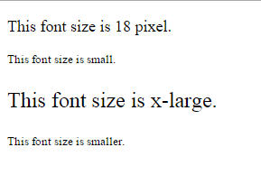
CSS Font-Size
CSS font-size property set the font size. Possible values could be xx-small, x-small, small, medium, large, x-large, xx-large, smaller, larger, size in pixels or in %.
<!DOCTYPE html>
<html>
<head>
<title>CSS Font Size</title>
</head>
<body>
<p style="font-size: 18px;">This font size is 18 pixel.</p>
<p style="font-size: small;">This font size is small.</p>
<p style="font-size: x-large;">This font size is x-large.</p>
<p style="font-size: smaller;">This font size is smaller.</p>
</body>
</html>

Slide 173
CSS Font-Size Adjust
CSS Font-Size Adjust property set the font size adjust of an element. This property enables you to adjust the x-height to make fonts more legible. Possible value could be any number.
<p style="font-size-adjust:0.61;">This text is using font style</p>
CSS Font-Stretch
CSS Font-Stretch property set the font stretch of an element. This property relies on the user's computer to have an expanded or condensed version of the font being used. Possible values could be normal, wider, narrower, ultra-condensed, extra-condensed, condensed, semi-condensed, semi-expanded, expanded, extra-expanded, ultra-expanded.
<p style="font-stretch:ultra-expanded;">This text is using font style</p>

Slide 174
CSS Font-Shorthands
CSS Font-Shorthands property set more than one (or) all the font properties at once.
<html>
<head>
</head>
<body>
<p style="font : italic small-caps bold 15px georgia;">
Applying all the properties on the text at once.
</p>
</body>
</html>

Slide 175
CSS Images
Image Border Property:
The border property of an image is used to set the width of an image border. This property can have a value in length or in %. A width of zero pixels means no border.
<body>
<img style = "border:0px;" src = "/css/images/logo.png" />
<br />
<img style = "border:3px dashed red;" src = "/css/images/logo.png" />
</body>
Image Height Property :
The height property of an image is used to set the height of an image. This property can have a value in length or in %.
<img style = "border:1px solid red; height:100px;" src = "/css/images/logo.png" />

Slide 176
3. Image Width Property:
The width property of an image is used to set the width of an image. This property can have a value in length or in %.
<img style = "border:1px solid red; width:150px;" src = "/css/images/logo.png" />
4. -moz-opacity Property:
The -moz-opacity property of an image is used to set the opacity of an image. This property is used to create a transparent image in Mozilla. IE uses filter:alpha(opacity=x) to create transparent images.
In Mozilla (-moz-opacity:x) x can be a value from 0.0 - 1.0. A lower value makes the element more transparent (The same things goes for the CSS3-valid syntax opacity:x).
In IE (filter:alpha(opacity=x)) x can be a value from 0 - 100. A lower value makes the element more transparent.
<img style = "border:1px solid red; -moz-opacity:0.4; filter:alpha(opacity=40);" src = "/css/images/logo.png" />

Slide 177
CSS Background Properties
CSS Background properties like background-color, background-image, background-position, background-repeat, background-attachment properties and many more.
CSS background-color=set background color.
<p style="background-color: orange;">This text background color orange.</p>
CSS background-image
<p style="background-image:url(../../images/img_nat.png); color:#FFFFFF; height:130px; width:200px; font-size:20px;">This text element set background image.</p>

Slide 178
CSS background-repeat
CSS background-repeat property repeat image both side horizontally or vertically. CSS background-repeat property possible value is repeat, no-repeat, repeat-x (vertically repeat), and repeat-y (horizontally repeat).
<p style="background-image:url(../../images/img_nat.png); height:120px; background-repeat: no-repeat;“>This element represent background-repeat property.</p>
CSS background-attachment
<p style="background-image: url(../../images/img_nat.png); height: 130px; width: 200px; overflow: scroll; background-attachment:fixed; color: white;“>This element represent background-attachment property. It means image does not moved only fixed attached a image. background attachment possible value fixed or scroll. you can use this value and display results.This example is Background attachment image is fixed means image does not moved only fixed attached a image. background attachment possible value fixed or scroll. you can use this value and display results.</p>
CSS background-position
CSS background-position property use to set background image in different type position like left, right, center, top, bottom.
<p style="background-image:url(../../images/img_nat.png); height:120px; background-repeat: no-repeat; background-position: 150px;">This element represent background-position property. </p>

Slide 179
CSS - Links
CSS Links set different properties of a hyper link using CSS. You can set following properties of a hyper link −
The :link signifies unvisited hyperlinks.
The :visited signifies visited hyperlinks.
The :hover signifies an element that currently has the user's mouse pointer hovering over it.
The :active signifies an element on which the user is currently clicking.
Here some rules apply when you set the style for hyperlink.
a:hover always come after a:link or a:visited
a:active always come after a:hover
<style type = "text/css">
a:link {color: #000000}
a:visited {color: #006600}
a:hover {color: #FFCC00}
a:active {color: #FF00CC} </style>

Slide 180
Set the Color of Links
<html> <head>
<style type = "text/css">
a:link {color:#000000}
a:visited {color: #006600} </style>
</head>
<body>
<a href = "">Link</a>
</body> </html>
CSS Links Background Color
<head>
<style type="text/css"> a:link {background-color:#CCCCCC;} </style>
</head>
CSS Links Text Decoration
<head>
<style type="text/css"> a:link { text-decoration: none; }
a:hover { text-decoration: underline; } </style>
</head>

Slide 181
CSS Lists
Lists are very helpful in conveying a set of either numbered or bullet points. We have the following five CSS properties, which can be used to control lists −
The list-style-type allows you to control the shape or appearance of the marker.
The list-style-position specifies whether a long point that wraps to a second line should align with the first line or start underneath the start of the marker.
The list-style-image specifies an image for the marker rather than a bullet point or number.
The list-style serves as shorthand for the preceding properties.
The marker-offset specifies the distance between a marker and the text in the list.

Slide 182
CSS list-style-type
CSS list-style-type property use for display list item either Ordered or Unordered list.
Ordered list possible value roman, alpha, numeric and manymore. Unordered list possible value circle, square, disk and none.
List Style Type possible values see the list-style-type:
Unordered list value
Value | Description
disk | disk type list item display, this is default value
circle | Circle type list item display
square | Square type list item display.
none | Nothing any style apply in list item

Slide 183
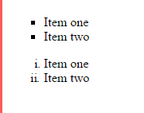
<body>
<ul style="list-style-type: square;">
<li>Item one</li>
<li>Item two</li>
</ul>
<ul style="list-style-type: lower-roman;">
<li>Item one</li>
<li>Item two</li>
</ul> </body>
Ordered list value
Value | Description
decimal | decimal type numeric list style (eg. 1, 2, 3 and so on.) this is default value.
upper-alpha | Uppercase alphabetically list style (eg. A, B, C ans so on.)
lower-alpha | Lowercase alphabetically list style (eg. a, b, c and so on.)
upper-roman | Uppercase roman numerals list (eg. I, II, III and so on.)
lower-roman | Lowercase roman numerals list (eg. i, ii, iii and so on.)

Slide 184
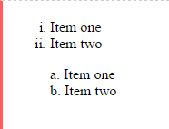
CSS list-style-image
CSS list-style-image property set list style URL specified image.
<body>
<ul style="list-style-image: url(../../images/new.png);">
<li>Item one</li>
<li>Item two</li>
</ul>
CSS list-style-position
CSS list-style-position set list style position either inside or outside.
<ul style="list-style-position: outside; list-style-type: lower-roman;">
<li>Item one</li>
<li>Item two</li>
</ul>
<ul style="list-style-position: inside; list-style-type: lower-alpha;">
<li>Item one</li>
<li>Item two</li>
</ul>

Slide 185
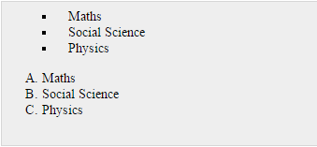
The marker-offset Property
The marker-offset property allows you to specify the distance between the marker and the text relating to that marker. Its value should be a length as shown in the following example −
<body>
<ul style = "list-style: inside square; marker-offset:2em;">
<li>Maths</li>
<li>Social Science</li>
<li>Physics</li>
</ul>
<ol style = "list-style: outside upper-alpha; marker-offset:2cm;"> <li>Maths</li>
<li>Social Science</li>
<li>Physics</li>
</ol>
</body>

Slide 186
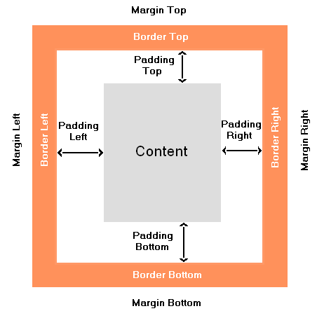
CSS Layout Style
CSS Layout Box Model-CSS layout box model give you layout knowledge of element content and how to set padding, margin or border. CSS layout allow you to set border around padding and set margin around content to better manage.
Margin
Margin are border outside area. So margin is not support any special CSS properties exclude margin group properties It is use to leave a blank space around element content.
Border
Border are define the border around element content. It is use to display border outside content(like text, images and so forth).
Padding
Padding define the content or border in this two part middle part are call padding. It is use to leave blank space between content or border.
Width or Height of Elements
You can specify width or hight either absolute or relative value.
Total width count by this way, Total width = width + left padding + right padding + left border + right border + left margin + right margin Total Height count by this way, Total Height = height + top padding + bottom padding + top border + bottom border + top margin + bottom margin

Slide 187
CSS Border
CSS Border properties give you control to set border style.
Border | Border Properties
border-top | border-top-color border-top-style border-top-width
border-bottom | border-bottom-color border-bottom-style border-bottom-width
border-left | border-left-color border-left-style border-left-width
border-right | border-right-color border-right-style border-right-width

Slide 188
<!DOCTYPE html>
<html>
<head>
<title>CSS border property</title>
</head>
<body>
<p style="border-style: solid; border-width:1px; border-color: orange;">
This paragraph represent the CSS border properties. This way you can change the border color, border width or border style.</p>
</body>
</html>

Slide 189
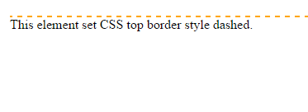
CSS border shorthand property
<body>
<p style="border-top:2px dashed orange;">
This element set CSS top border style dashed.</p>
</body>
CSS border-style property
<!DOCTYPE html> <html>
<head>
<title>CSS border property</title>
</head>
<body>
<p style="border: 2px solid orange;">This element border style solid.</p>
<p style="border: 2px dotted orange;">This element border style dotted.</p>
<p style="border: 2px dashed orange;">This element border style dashed.</p>
<p style="border: 2px double orange;">This element border style double.</p>
<p style="border: 2px groove orange;">This element border style groove.</p>
<p style="border: 2px ridge orange;">This element border style ridge.</p>
<p style="border: 2px inset orange;">This element border style inset.</p>
<p style="border: 2px outset orange;">This element border style outset.</p>
<p style="border: 2px hidden orange;">This element border style hidden.</p>
</body> </html>

Slide 191
CSS border-radius Property
The CSS border-radius property defines the radius of an element's corners.
1. Rounded corners for an element with a specified background color:
2. Rounded corners for an element with a border:
3. Rounded corners for an element with a background image:
<!DOCTYPE html> <html> <head>
<style>
#rcorners1 { border-radius: 25px; background: #73AD21; padding: 20px; width: 200px; height: 150px; }
#rcorners2 { border-radius: 25px; border: 2px solid #73AD21; padding: 20px; width: 200px; height: 150px; }
#rcorners3 { border-radius: 25px; background: url(paper.gif); background-position: left top; background-repeat: repeat; padding: 20px; width: 200px; height: 150px; }
</style> </head>
<body> <h1>The border-radius Property</h1>
<p>Rounded corners for an element with a specified background color:</p>
<p id="rcorners1">Rounded corners!</p>
<p>Rounded corners for an element with a border:</p>
<p id="rcorners2">Rounded corners!</p>
<p>Rounded corners for an element with a background image:</p>
<p id="rcorners3">Rounded corners!</p>
</body> </html>

Slide 192
<!DOCTYPE html> <html> <head>
<style>
#rcorners1 { border-radius: 15px 50px 30px 5px; background: #73AD21; padding: 20px;
width: 200px; height: 150px; }
#rcorners2 { border-radius: 15px 50px 30px; background: #73AD21; padding: 20px;
width: 200px; height: 150px; }
#rcorners3 { border-radius: 15px 50px; background: #73AD21; padding: 20px; width: 200px;
height: 150px; }
#rcorners4 { border-radius: 15px; background: #73AD21; padding: 20px; width: 200px;
height: 150px; }
</style> </head>
<body>
<h1>The border-radius Property</h1>
<p>Four values - border-radius: 15px 50px 30px 5px:</p>
<p id="rcorners1"></p>
<p>Three values - border-radius: 15px 50px 30px:</p>
<p id="rcorners2"></p>
<p>Two values - border-radius: 15px 50px:</p>
<p id="rcorners3"></p>
<p>One value - border-radius: 15px:</p>
<p id="rcorners4"></p>
</body>
</html>

Slide 193
CSS box-shadow Property
The box-shadow property attaches one or more shadows to an element.
CSS Syntax
box-shadow: none|h-offset v-offset blur spread color |inset|initial|inherit;
Property Values
Value | Description
none | Default value. No shadow is displayed
h-offset | Required. The horizontal offset of the shadow. A positive value puts the shadow on the right side of the box, a negative value puts the shadow on the left side of the box
v-offset | Required. The vertical offset of the shadow. A positive value puts the shadow below the box, a negative value puts the shadow above the box
blur | Optional. The blur radius. The higher the number, the more blurred the shadow will be
spread | Optional. The spread radius. A positive value increases the size of the shadow, a negative value decreases the size of the shadow
color | Optional. The color of the shadow. The default value is the text color.
inset | Optional. Changes the shadow from an outer shadow (outset) to an inner shadow
initial | Sets this property to its default value.
inherit | Inherits this property from its parent element.

Slide 194
Example-1
Add a blur effect to the shadow:
<!DOCTYPE html> <html> <head>
<style>
#example1 { border: 1px solid; padding: 10px; box-shadow: 5px 10px 8px #888888; }
#example2 { border: 1px solid; padding: 10px; box-shadow: 5px 10px 18px #888888; }
#example3 { border: 1px solid; padding: 10px; box-shadow: 5px 10px 18px red; }
</style> </head>
<body>
<h2>box-shadow: 5px 10px 8px #888888:</h2>
<div id="example1">
<p>The optional third value adds a blur effect to the shadow.</p>
</div>
<h2>box-shadow: 5px 10px 18px #888888:</h2>
<div id="example2">
<p>More blurred.</p>
</div>
<h2>box-shadow: 5px 10px 18px red:</h2>
<div id="example3">
<p>More blurred and red.</p>
</div>
</body> </html>

Slide 195
Example-2
Define the spread radius of the shadow:
<!DOCTYPE html>
<html>
<head>
<style>
#example1 {
border: 1px solid;
padding: 10px;
box-shadow: 5px 10px 8px 10px #888888;
}
</style>
</head>
<body>
<h2>box-shadow: 5px 10px 8px 10px #888888:</h2>
<div id="example1">
<p>The optional fourth value defines the spread of the shadow.</p>
</div>
</body>
</html>

Slide 196
Example-3
Define multiple shadows:
<!DOCTYPE html> <html> <head> <style>
#example1 {
border: 1px solid; padding: 10px;
box-shadow: 5px 5px blue, 10px 10px red, 15px 15px green; }
#example2 {
border: 1px solid; padding: 10px;
box-shadow: 5px 5px 8px blue, 10px 10px 8px red, 15px 15px 8px green;
}
</style> </head>
<body>
<h2>box-shadow: 5px 5px blue, 10px 10px red, 15px 15px green:</h2>
<div id="example1">
<p>Define multiple shadows.</p>
</div>
<h2>box-shadow: 5px 5px 8px blue, 10px 10px 8px red, 15px 15px 8px green:</h2>
<div id="example2">
<p>Define multiple shadows with blur effect.</p>
</div>
</body></html>

Slide 197
Example-4
Add the inset keyword:
<!DOCTYPE html>
<html>
<head>
<style>
#example1 { border: 1px solid; padding: 10px; box-shadow: 5px 10px inset; }
#example2 { border: 1px solid; padding: 10px; box-shadow: 5px 10px 20px red inset;}
</style>
</head>
<body>
<h2>box-shadow: 5px 10px inset:</h2>
<div id="example1">
<p>The inset keyword changes the shadow to one inside the frame.</p>
</div>
<h2>box-shadow: 5px 10px 20px red inset:</h2>
<div id="example2">
<p>Inset, red and blur.</p>
</div>
</body>
</html>

Slide 198
Example-4
Images thrown on the table. This example demonstrates how to create "polaroid" pictures and rotate the pictures:
<!DOCTYPE html> <html> <head>
<style>
body { margin: 30px; background-color: #E9E9E9;}
div.polaroid { width: 284px; padding: 10px 10px 20px 10px; border: 1px solid #BFBFBF;
background-color: white; box-shadow: 10px 10px 5px #aaaaaa;
}
div.rotate_right { float: left;
-ms-transform: rotate(7deg); /* IE 9 */
-webkit-transform: rotate(7deg); /* Safari */
transform: rotate(7deg);
}
div.rotate_left { float: left;
-ms-transform: rotate(-8deg); /* IE 9 */
-webkit-transform: rotate(-8deg); /* Safari */
transform: rotate(-8deg);
}
</style></head>
<body>
<div class="polaroid rotate_right">
<img src="pulpitrock.jpg" alt="Pulpit rock" width="284" height="213">
<p class="caption">The pulpit rock in Lysefjorden, Norway.</p>
</div>
<div class="polaroid rotate_left">
<img src="cinqueterre.jpg" alt="Monterosso al Mare" width="284" height="213">
<p class="caption">Monterosso al Mare. One of the five villages in Cinque Terre, Italy.</p>
</div>
</body></html>

Slide 199
CSS border-image Property
The CSS border-image property allows you to specify an image to be used instead of the normal border around an element.
The property has three parts:
The image to use as the border
Where to slice the image
Define whether the middle sections should be repeated or stretched
<!DOCTYPE html><html><head>
<style>
#borderimg1 { border: 10px solid transparent; padding: 15px; border-image: url(border.png) 50 round;}
#borderimg2 { border: 10px solid transparent; padding: 15px; border-image: url(border.png) 20% round;}
#borderimg3 { border: 10px solid transparent; padding: 15px; border-image: url(border.png) 30% round;}
</style> </head>
<body>
<h1>The border-image Property</h1>
<p id="borderimg1">border-image: url(border.png) 50 round;</p>
<p id="borderimg2">border-image: url(border.png) 20% round;</p>
<p id="borderimg3">border-image: url(border.png) 30% round;</p>
<p><strong>Note:</strong> Internet Explorer 10, and earlier versions, do not support the border-image property.</p> </body>
</html>

Slide 200
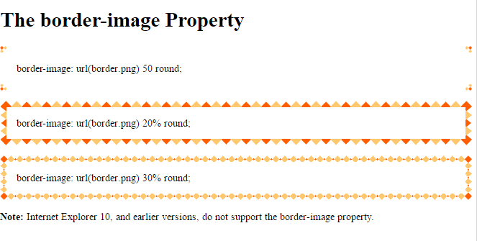

Slide 201
CSS Margin
CSS Margin property leave blank space around the content elements (outside of border). CSS Margin property support pixel, percentage or auto measurement value.
Properties | Value | Description
margin | px % auto | User define pixel value. User define percentage value. Set automatic.
margin-left | px % auto | margin left side set define pixel value. margin left side set User define percentage value. margin left side Set automatic.
margin-right | px % auto | margin right side set User define pixel value. margin right side set User define percentage value. margin right side set Set automatic.
margin-top | px % auto | margin top set user define pixel value. margin top set user define percentage value. margin top set automatic.
margin-bottom | px % auto | margin bottom set user define pixel value. margin bottom set user define percentage value. margin bottom set automatic.

Slide 202
<!DOCTYPE html>
<html>
<head>
<title>CSS margin property</title>
<style type="text/css">
p.first { border: 1px solid orange; margin-left: 30px; }
p.second { border: 1px solid orange; margin-left: 20%; }
p.third { border: 1px solid orange; margin-left: auto; }
</style>
</head>
<body>
<p class="first">This element set margin-left, border width, border color, border style CSS properties.</p>
<p class="second">This element set margin-left, border width, border color, border style CSS properties.</p>
<p class="third">This element set margin-left, border width, border color, border style CSS properties.</p>
</body>
</html>

Slide 203
CSS Margin shorthand property
CSS margin property write in shorthand way including following margin properties:
1. margin-top
2. margin-right
3. margin-bottom
4. margin-left
Margin value how to set
Value | Description
margin: 12px; | all 4 side margin 12 pixel.
margin: 10px 20px; | top and bottom margin 10 pixel right side and left side margin 20 pixel.
margin: 10px 20px 30px; | top margin 10 pixel left side and right side margin 20 pixel bottom margin is 30 pixel.
margin: 10px 20px 30px 40px; | top margin is 10 pixel right side margin is 20 pixel bottom margin is 30 pixel left side margin is 40 pixel.

Slide 204
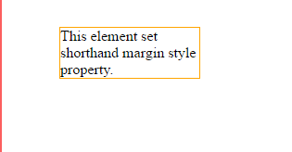
<!DOCTYPE html>
<html>
<head>
<title>CSS margin property</title>
<style type="text/css">
p {
border: 1px solid orange; margin: 25px 25px 5px 50px; width: 150px;
}
</style>
</head>
<body>
<p class="first">
This element set shorthand margin style property.
</p>
</body>
</html>

Slide 205
CSS Padding
CSS Padding property leave blank space around the element content (inside of border). CSS Padding property support pixel, percentage or auto value.
Properties | Value | Description
padding | px % auto | User define pixel value. User define percentage value. Set automatic.
padding-left | px % auto | padding left side set define pixel value. padding left side set User define percentage value. padding left side Set automatic.
padding-right | px % auto | padding right side set User define pixel value. padding right side set User define percentage value. padding right side set Set automatic.
padding-top | px % auto | padding top set user define pixel value. padding top set user define percentage value. padding top set automatic.
padding-bottom | px % auto | padding bottom set user define pixel value. padding bottom set user define percentage value. padding bottom set automatic.

Slide 206
<!DOCTYPE html>
<html>
<head>
<title>CSS padding property</title>
<style type="text/css">
p.first { border: 1px solid orange; padding-left: 30px; }
p.second { border: 1px solid orange; padding-left: 20%; }
p.third { border: 1px solid orange; padding-left: auto; }
</style>
</head>
<body>
<p class="first">This element set padding-left, border width, border color, border style CSS properties.</p>
<p class="second">This element set padding-left, border width, border color, border style CSS properties.</p>
<p class="third">This element set padding-left, border width, border color, border style CSS properties.</p>
</body>
</html>

Slide 207
CSS Padding shorthand property
CSS padding property write in shorthand way including following padding properties:
1. padding-top
2. padding-right
3. padding-bottom
4. padding-left
Margin value how to set
Value | Description
padding: 12px; | all 4 side padding 12 pixel.
padding: 10px 20px; | top and bottom padding 10 pixel right side and left side padding 20 pixel.
padding: 10px 20px 30px; | top padding 10 pixel left side and right side padding 20 pixel bottom padding is 30 pixel.
padding: 10px 20px 30px 40px; | top padding is 10 pixel right side padding is 20 pixel bottom padding is 30 pixel left side padding is 40 pixel.

Slide 208
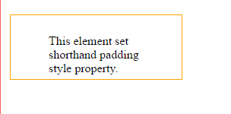
<!DOCTYPE html>
<html>
<head>
<title>CSS padding property</title>
<style type="text/css">
p {
border: 1px solid orange; padding: 25px 25px 50px 50px; width: 150px; }
</style>
</head>
<body>
<p class="first">This element set shorthand padding style property.</p>
</body>
</html>

Slide 209
CSS Display
CSS display property use for how to display list of item. Possible value is inline, block, inline-block and so on.
CSS display Property
Syntax | Value | Description
display | inline block inline-block none | value specify how to list display inline, block, inline-block and none of display.

Slide 210
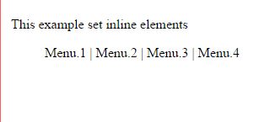
CSS display:inline style
CSS display inline means elements displayed inline in current block of line.
Example
<!DOCTYPE html>
<html>
<head>
<title>CSS display property</title>
<style type="text/css">
li { display: inline; }
</style>
</head>
<body>
<p>This example set inline elements</p>
<ul>
<li>Menu.1</li> |
<li>Menu.2</li> |
<li>Menu.3</li> |
<li>Menu.4</li>
</ul>
</body>
</html>

Slide 211
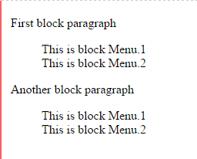
CSS display:block style
CSS display block means elements displayed as a block. Header and Paragraphs
are always in block style.
Example
<!DOCTYPE html>
<html>
<head>
<title>CSS display property</title>
<style type="text/css">
li { display: block; }
</style>
</head>
<body>
<p>First block paragraph</p>
<ul>
<li>This is block Menu.1</li>
<li>This is block Menu.2</li>
</ul>
<p>Another block paragraph</p>
<ul>
<li>This is block Menu.1</li>
<li>This is block Menu.2</li>
</ul>
</body>
</html>

Slide 212
CSS display:inline-block style
CSS display inline-block means elements is display as a inline but it's behaves is like block type.
Example
<!DOCTYPE html>
<html>
<head>
<title>CSS display property</title>
<style type="text/css">
li { display:inline-block; }
</style>
</head>
<body>
<p>First block paragraph</p>
<ul>
<li>This is block menu.1</li>
<li>This is block menu.2</li>
</ul>
<p>Another block paragraph</p>
<ul>
<li>This is block menu.1</li>
<li>This is block menu.2</li>
</ul>
</body>
</html>

Slide 213
CSS display:none style
CSS display type none means element is not display, element is no longer display.
Example
<!DOCTYPE html>
<html>
<head>
<title>CSS display property</title>
<style type="text/css">
li { display:none; }
</style>
</head>
<body>
<p>First block paragraph</p>
<ul>
<li>This is block menu.1</li>
<li>This is block menu.2</li>
</ul>
<p>Another block paragraph</p>
<ul>
<li>This is block menu.1</li>
<li>This is block menu.2</li>
</ul>
</body>
</html>

Slide 214
CSS Position
CSS position property set an element positioning to display in web page. CSS position property possible value relative, absolute and fixed.
CSS position:relative property
CSS position:relative property set element relatively followed by the relative offset from top, right, bottom or left. Relative position is related to each and every around element properties (like margin, background-color and so forth).
Example
<!DOCTYPE html>
<html>
<head>
<title>CSS position property</title>
</head>
<body>
<div style="position: relative; left: 120px; background-color: orange; width: 120px;"> This element is a relative positioning for each elements.
</div>
</body>
</html>

Slide 215
CSS position:absolute property
CSS position:absolute property set element absolutely followed by the absolute offset from top, right, bottom or left. Relative positioning element inside you can set absolute position element.
Example
<!DOCTYPE html>
<html>
<head>
<title>CSS position property</title>
</head>
<body>
<div style="position: relative; width: 400px; height: 150px; border: 1px solid orange;">
<div style="position: absolute; top: 35px; left: 220px; width: 160px; background-color: orange;">This element is a absolute positioning for each elements.
</div>
</div>
</body>
</html>

Slide 216
CSS position:fixed property
CSS position:fixed property set element in fixed, even if window scroll vertically or horizontally element is fixed place. CSS position fixed followed by the window offset top, right, bottom, left.
Example
<!DOCTYPE html>
<html>
<head>
<title>CSS position property</title>
</head>
<body>
<div style="width:400px; height:150px; border: 1px solid orange; overflow: scroll;">
<div style="position: fixed; top: 35px; left: 220px; width: 100px; background- color: orange;">Fixed element</div>
CSS background-repeat property repeat image both side horizontally or vertically. CSS background-repeat property possible value is repeat, no-repeat, repeat-x (vertically repeat), and repeat-y (horizontally repeat).<br />
CSS background-repeat property repeat image both side horizontally or vertically.CSS background-repeat property possible value is repeat, no-repeat, repeat-x (vertically repeat), and repeat-y (horizontally repeat).<br />
CSS background-repeat property repeat image both side horizontally or vertically. CSS background-repeat property possible value is repeat, no-repeat, repeat-x (vertically repeat), and repeat-y (horizontally repeat). </div>
</body>
</html>

Slide 217
CSS - Cursors
The cursor property of CSS allows you to specify the type of cursor that should be displayed to the user.
Sr.No. | Value & Description
1 | auto Shape of the cursor depends on the context area it is over. For example an I over text, a hand over a link, and so on...
2 | crosshair A crosshair or plus sign
3 | default An arrow
4 | pointer A pointing hand (in IE 4 this value is hand)
5 | move The I bar
6 | e-resize The cursor indicates that an edge of a box is to be moved right (east)
7 | ne-resize The cursor indicates that an edge of a box is to be moved up and right (north/east)
8 | nw-resize The cursor indicates that an edge of a box is to be moved up and left (north/west)

Slide 218
Sr.No. | Value & Description
9 | n-resize The cursor indicates that an edge of a box is to be moved up (north)
10 | se-resize The cursor indicates that an edge of a box is to be moved down and right (south/east)
11 | sw-resize The cursor indicates that an edge of a box is to be moved down and left (south/west)
12 | s-resize The cursor indicates that an edge of a box is to be moved down (south)
13 | w-resize The cursor indicates that an edge of a box is to be moved left (west)
14 | text The I bar
15 | wait An hour glass
16 | help A question mark or balloon, ideal for use over help buttons
17 | <url> The source of a cursor image file

Slide 219
<html>
<head>
</head>
<body>
<p>Move the mouse over the words to see the cursor change:</p>
<div style="cursor:auto">Auto</div>
<div style="cursor:crosshair">Crosshair</div>
<div style="cursor:default">Default</div>
<div style="cursor:pointer">Pointer</div>
<div style="cursor:move">Move</div>
<div style="cursor:e-resize">e-resize</div>
<div style="cursor:ne-resize">ne-resize</div>
<div style="cursor:nw-resize">nw-resize</div>
<div style="cursor:n-resize">n-resize</div>
<div style="cursor:se-resize">se-resize</div>
<div style="cursor:sw-resize">sw-resize</div>
<div style="cursor:s-resize">s-resize</div>
<div style="cursor:w-resize">w-resize</div>
<div style="cursor:text">text</div>
<div style="cursor:wait">wait</div>
<div style="cursor:help">help</div>
</body>
</html>

Slide 221
<span> and <div> Tags
<span> Tag:
It is used to group elements for styling purposes so that some text which are grouped will appear differently in a paragraph. That means we can differentiate particular text using font-size, color, font-family, font-style and so on.
<!DOCTYPE html> <html>
<head>
<title> Span Demo </title>
<style type = "text/css">
.myspan
{ font-size:28px; font-family:Arial;
color:green; background-color:yellow;
}
</style>
</head>
<body>
<h3>Twinkle Twinkle<span class="myspan">little</span>stars</h3>
</body>
</html>

Slide 222
<div> Tag:
Div tag is similar to span tag where div is a block-level tag but span is an inline tag. The div tag is known as Division tag. The div tag is used to make divisions of content in the web page like (text, images, header, footer, navigation bar, etc). The Div is the most usable tag in web development because it helps us to separate out data in the web page and we can create a particular section for particular data or function in the web pages.
<!DOCTYPE html> <html> <head>
<title> Div Demo </title>
<style type = "text/css">
.mysection
{ font-size:28px;
font-family:'monotype corsiva';
background-color:yellow;}
</style> </head>
<body>
<div class="mysection">
<p> Div tag is Block level tag. It is a generic container tag</p>
<p>It is used to the group of various tags of HTML .</p>
</body>
</html>

Slide 223
References
https://way2tutorial.com/html/tutorial.php
https://coursesweb.net/html
https://www.geeksforgeeks.org/html-tutorials/
https://www.tutorialride.com/html/html-tutorial.htm
https://www.w3schools.com/html/
https://www.tutorialspoint.com/html/index.htm
https://tutorialehtml.com/en/html-tutorial-complete-html-guide/

Slide 224
Thank You !!

